Slide 1
Sheet Resistance Measurements
Jacob Christy & Mitch Frand
06/28/2017

Slide 2
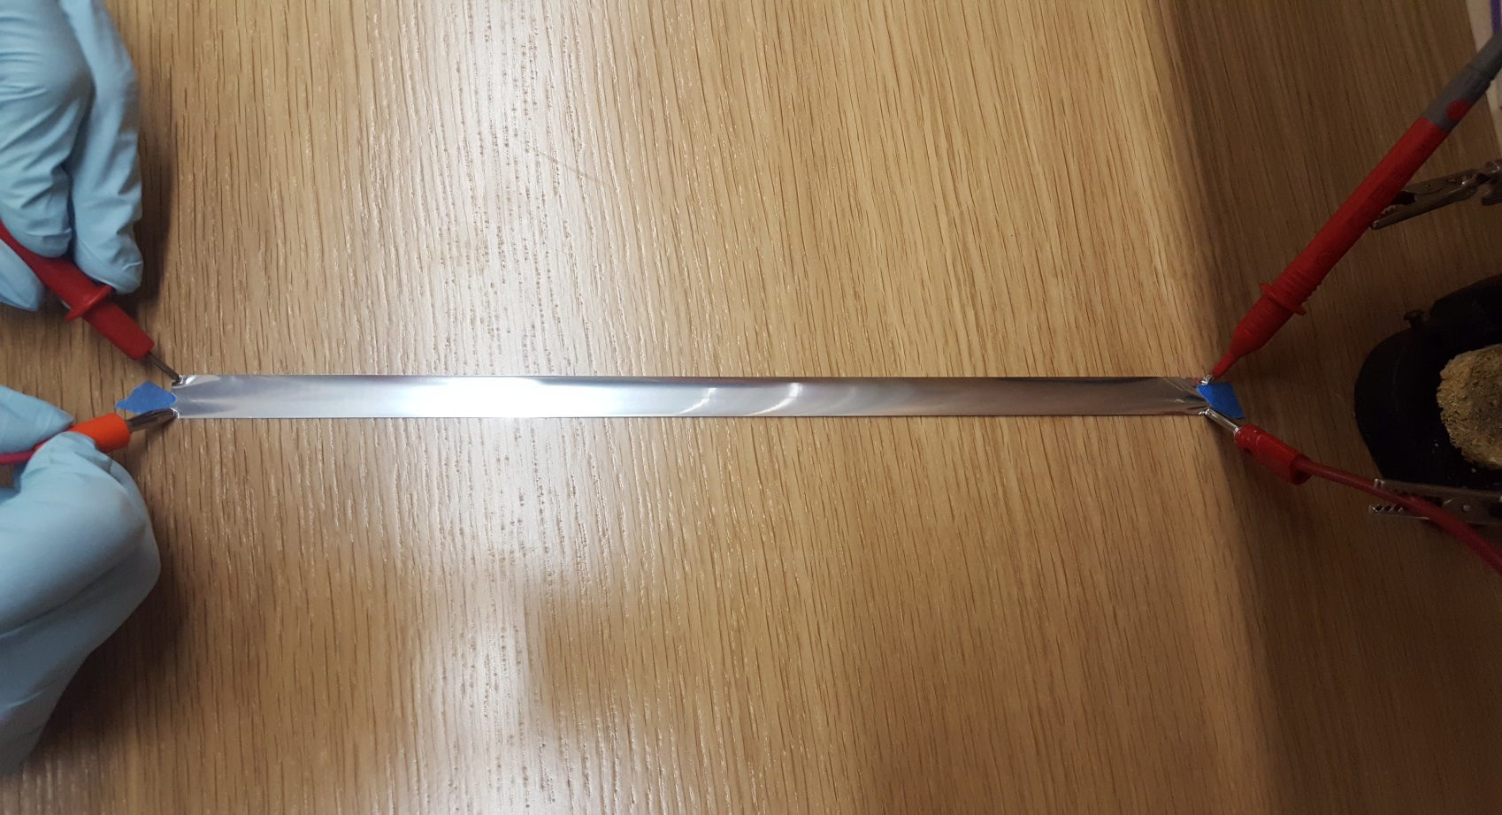
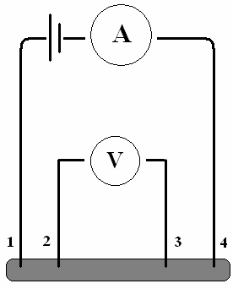
Sheet Resistance Measurements (cont.)
Current technique: four wire technique (Van der Pauw/Kelvin Sensing) on 3 separate ½” strips sampled from mylar batches.

Slide 3
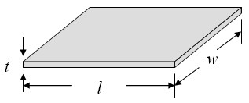
Sheet Resistance Measurements (cont.)
$R_{s}=\frac{ρ}{t}=R\frac{W}{L}$
Error propagation relation:
$σ_{R_{s}}=\sqrt{σ_{R}^{2}\frac{W_{}^{2}}{L_{}^{2}}+σ_{W}^{2}\frac{R_{}^{2}}{L_{}^{2}}+σ_{L}^{2}\frac{R_{}^{2}W_{}^{2}}{L_{}^{4}}}$

Slide 4
Measured Resistances
Lot #149366-1:
$R_{1}=17.7595±0.0035 Ω$
$R_{2}=17.5098 ±0.0035 Ω$
$R_{3}=17.2122 ±0.0035 Ω$
$R_{avg}=17.4938 ±0.0020 Ω$
Lot #149366-2:
$R_{1}=19.2068 ±0.0036 Ω$
$R_{2}=19.5180 ±0.0036 Ω$
$R_{3}=19. 8949±0.0036 Ω$
$R_{avg}=19.5399 ±0.0021 Ω$
Lot #149366-1:
$R_{s meas}=0.7186±0.0028\frac{Ω}{sq}$
Lot #149366-2:
$R_{s meas}=0.8026 ±0.0031\frac{Ω}{sq}$
Manufacturer’s specs give 0.857 Ω/sq.

