Slide 1
Progress at MN
Andrew Vold

Slide 2
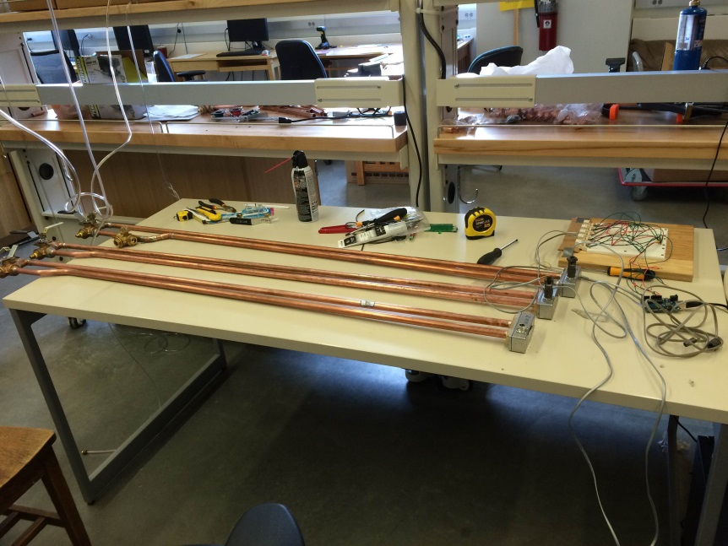
3 Chambers Ready
2 chambers connected to arduino
Several straws have been prepared
Making 1 more cable to connect 3rd chamber
Background measurements being taken

Slide 3
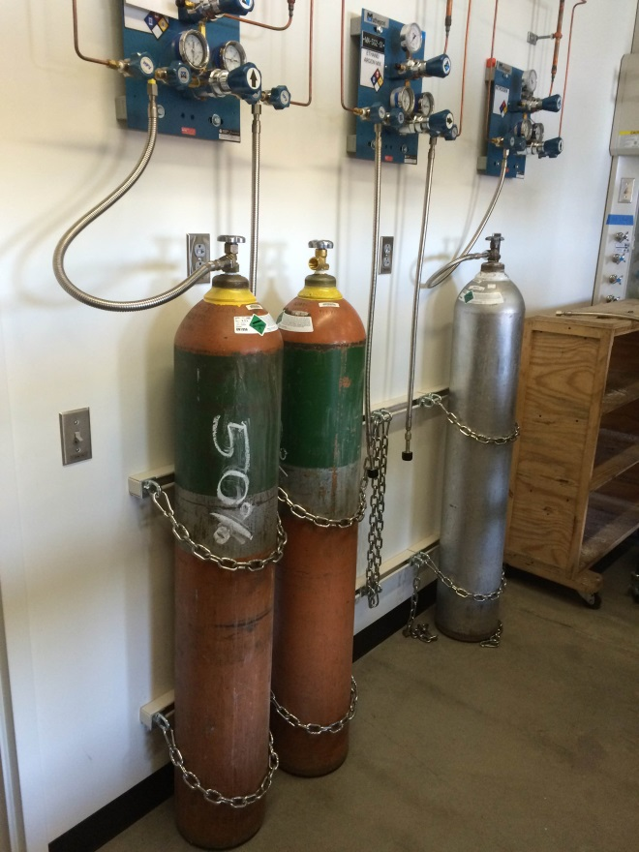
Gas Hooked Up
Gas is ready to go
Waiting for nozzles, flow-meters, and pressure gauges

