Slide 1
Pre-tensioning Setup and new Pallet
Farhan Abid

Slide 2
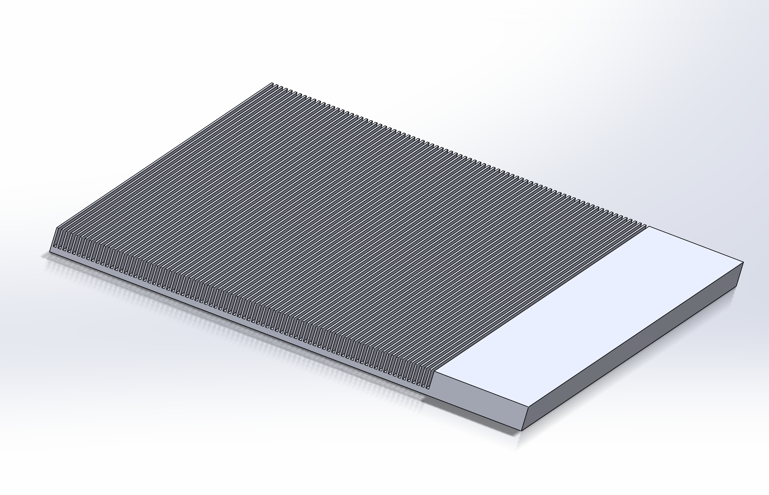
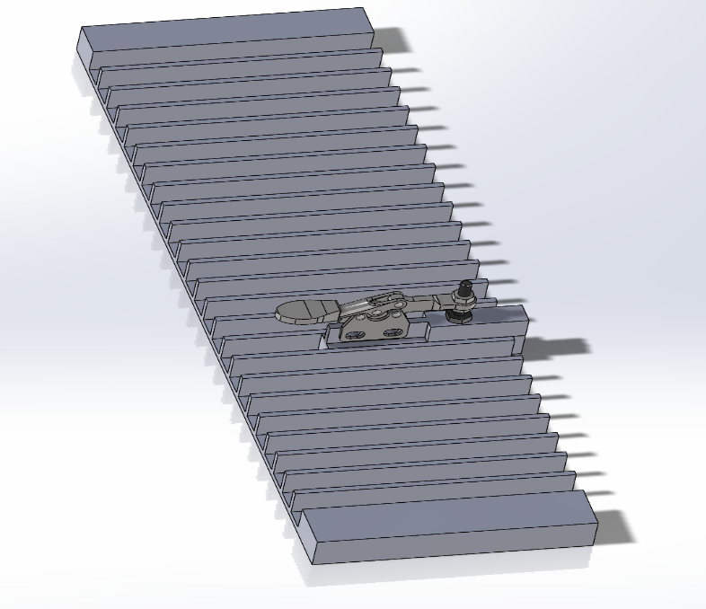
Pre-tensioning Setup
The parts shown below will be screwed together
The slotted plate will be at a lower elevation
Straws will be pulled through the troughs

Slide 3
Toggle clamp base

Slide 4
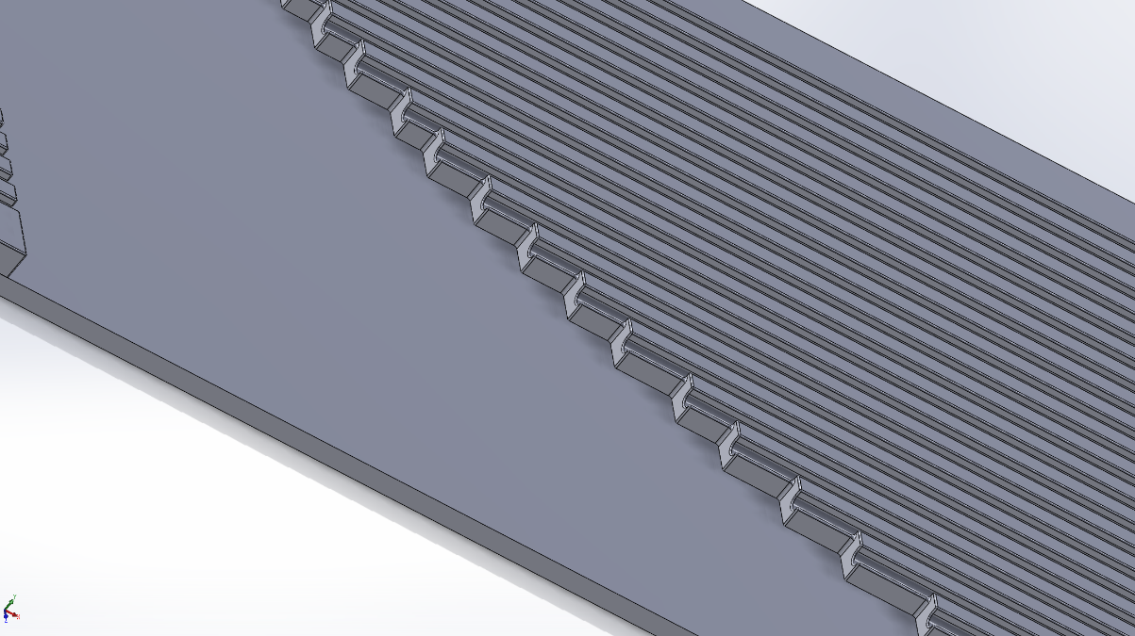
New Pallet
It is a step function rather than a curve
The base is longer
Grooves fit straws better and have curved edges

