Slide 1
New Pallets
Farhan Abid

Slide 2
General Pallet Functions
Hold straws firmly when extracting paper
Keep straws aligned during resistance measurements
Have enough room to epoxy CO2 end pieces
Allow straws to be tensioned while on the pallet
Allow straws to be pressurized while in pallet
Be aligned with the laser cutting table during cutting of straws

Slide 3
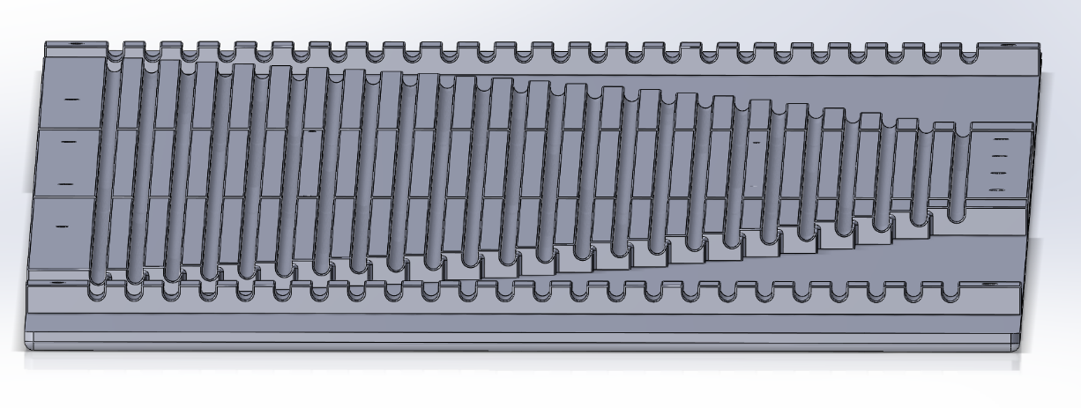
General Pallet

Slide 4
Loading Pallet
Function:
Line up well with the general pallet to facilitate transfer of straws
Line up perfectly with the panel to allow seamless transfer of straws

Slide 5
Loading Pallet

