Slide 1
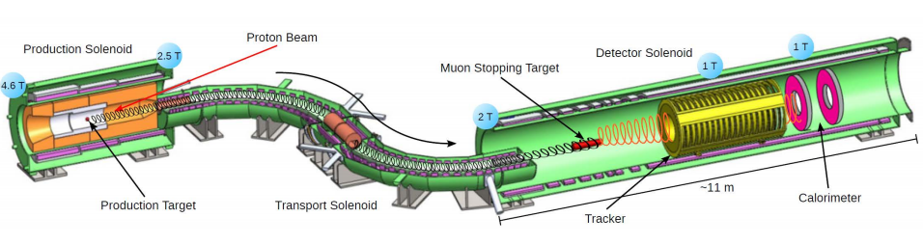
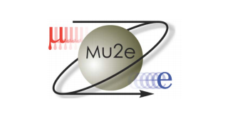
Mu2e :
10 Minutes in Questions
Dan Ambrose
University of Minnesota
New Perspectives
June 14, 2016

Slide 2
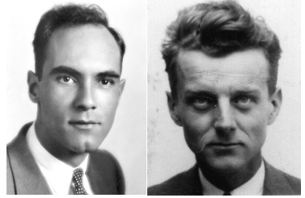
What’s up with the Muon?
1936: Anderson and Neddermeyer discover the muon
There are still unanswered mysteries surrounding the muon:
Anomalous magnetic dipole moment deviation from theory > 3σ
Quarks mix and Neutrinos mix. Shouldn’t we expect charged Leptons to mix?
Charge Lepton Flavor Violation (CLFV)
Mu2e Collaboration, November 2013

Slide 3
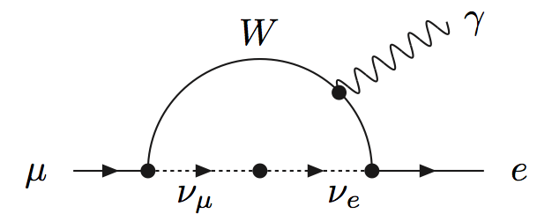
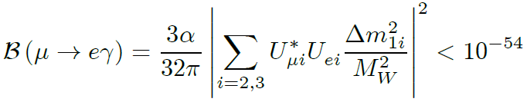
You mentioned CLFV. Does that happen?
With neutrino mass, we know that lepton flavor is not conserved.
The SM CLFV process would be :
*Physically unobservable
Any observation of CLFV must be new physics!

Slide 4
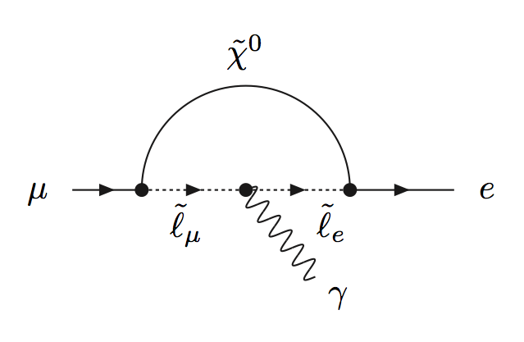
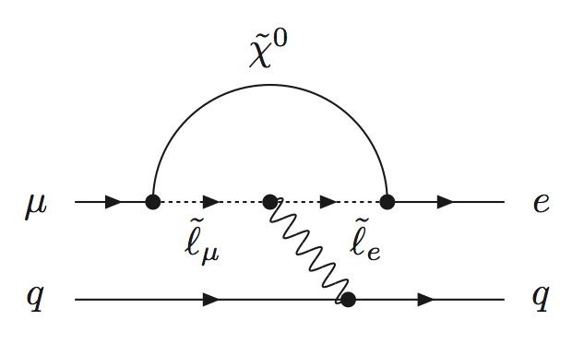


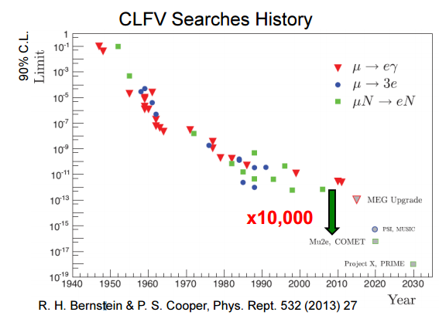




Sounds interesting. Have you tried looking for this?
$$μ→eγ$$
$$μ→eee$$
$$μN→eN$$
$$\overline{e}$$
4 orders of magnitude increased precision in incredible.
Fully operational Mu2e would be able to beat the current world best measurement with 1 hour of data.

Slide 5
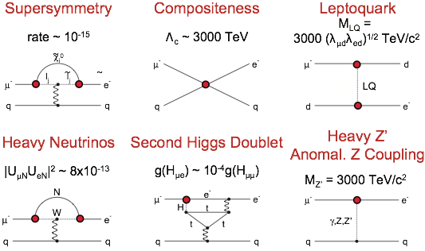
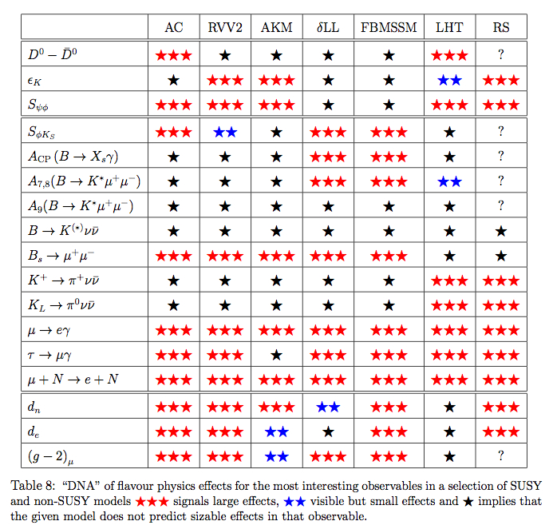

Soooo…Standard model predicts 10⁻⁵⁴ and Mu2e’s substantial increase just gets us to 10⁻¹⁷. I’m not excited, should I be?
YES!
W. Altmannshofer, A.J.Buras, S.Gori, P.Paradisi, D.M.Straub
arXiv:0909.1333[hep-ph]
Estimates from Flavour Physics of Leptons and Dipole Moments, Eur.Phys.J.C57:13-182,2008
$Λ_{c}$between 2000 to 7000 TeV

Slide 6
How are you going to measure this?
Generate a beam of low momentum muons (μ⁻)
Stop the muons in an Aluminum target
The stopped muons are trapped in orbit around the nucleus
Look for events consistent with μN→eN
We measure :
Numerator:
  Muon to electron conversion in the presence of a nucleolus
Denominator:
  Nuclear captures of muonic Al atoms
Mu2e Collaboration, November 2013

Slide 7
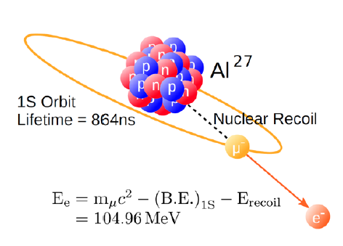
What would an event even look like?
When captured by a nucleus, a muon will have an enhanced probability of exchanging a virtual particle with the nucleus.
This reaction recoils against the entire nucleus, producing a mono-energetic electron carrying most of the muon rest energy.
Mu2e Collaboration, November 2013

Slide 8
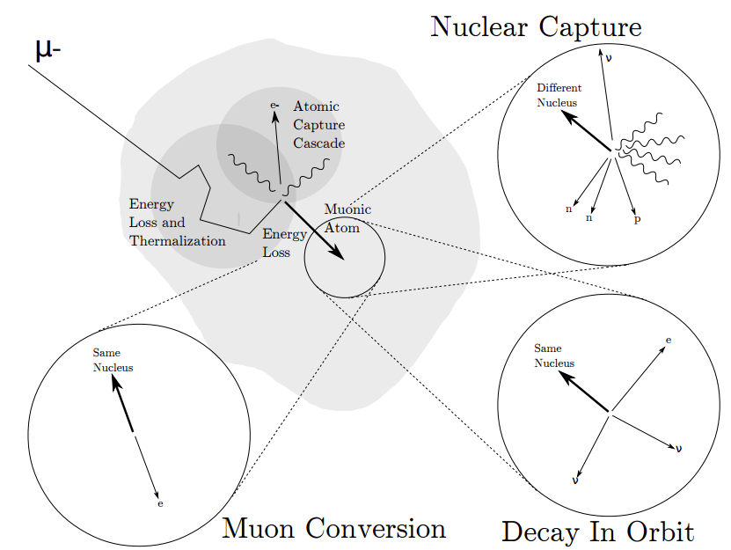

This being “crazy rare”, what is it doing the muon doing the rest of the time?
61%
<7x10⁻¹³
39%
Mu2e Collaboration, November 2013
*Image from talk by Kevin Lynch

Slide 9
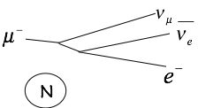
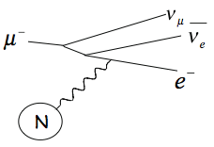
That decay in orbit also decays into an electron. Is that going to be a problem?
Free muon decay
M_{μ}
DIO shape
DIO tail
M_{μ} / 2
M_{μ}
Reconstructed Momentum (MeV)

Slide 10
That tail seemed to be getting close to the signal.
You sure that isn’t a problem?
Tail of DIO falls as (E_{Endpoint} – E_{e})⁵
Separation of ~few 100 keV for R_{μe} = 10⁻¹⁶
Experimental effects
Czarnecki, Tormo, Marciano
Phys.Rev. D84 (2011) 013006

Slide 11
Ok so maybe you could see it. Still, what does it take to measure 2.5×10⁻¹⁷ ?
Stop 10¹⁸ Muons in Aluminum stopping target
Momentum resolution σ < 180 keV/c
Reduce expected background to less than 1 event over full run period.
Tall tasks, but the accelerator and Mu2e have been designed to accomplish this.

Slide 12
What will the experiment look like?
Production Solenoid
Detector Solenoid
Transport Solenoid
25 m
3 main components: Production Solenoid (PS), Transport Solenoid (TS), and Detector Solenoid (DS)
Experimental setup contained within vacuum space
Gradient magnetic field (4.6 T → 1 T) moves charged particles downstream
Step 1:
  8 GeV proton beam hits tungsten target and produces Pions in PS
  Pions decaying into muons are pushed downstream towards TS
Step 2:
  TS selects particles based on charge and momentum
  TS collimators eliminate backgrounds
Step 3:
  Muons are captured in Aluminum target foils
  Conversion electron trajectories measured and validated in tracker and calorimeter

Slide 13
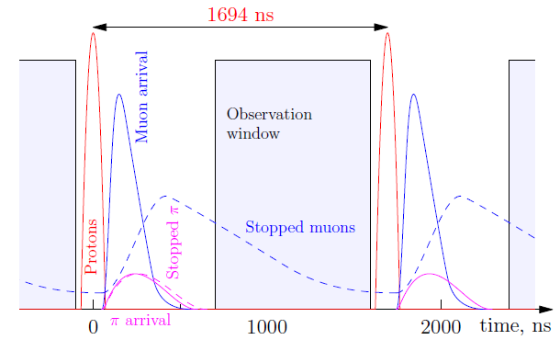
Do other beam particles get in the way?
~20,000 muons per bunch
10¹⁰ muons per second
Almost all protons, unstopped muons, stopped and unstopped pions will be through the detector before observation window.
Mu2e Collaboration, November 2013

Slide 14
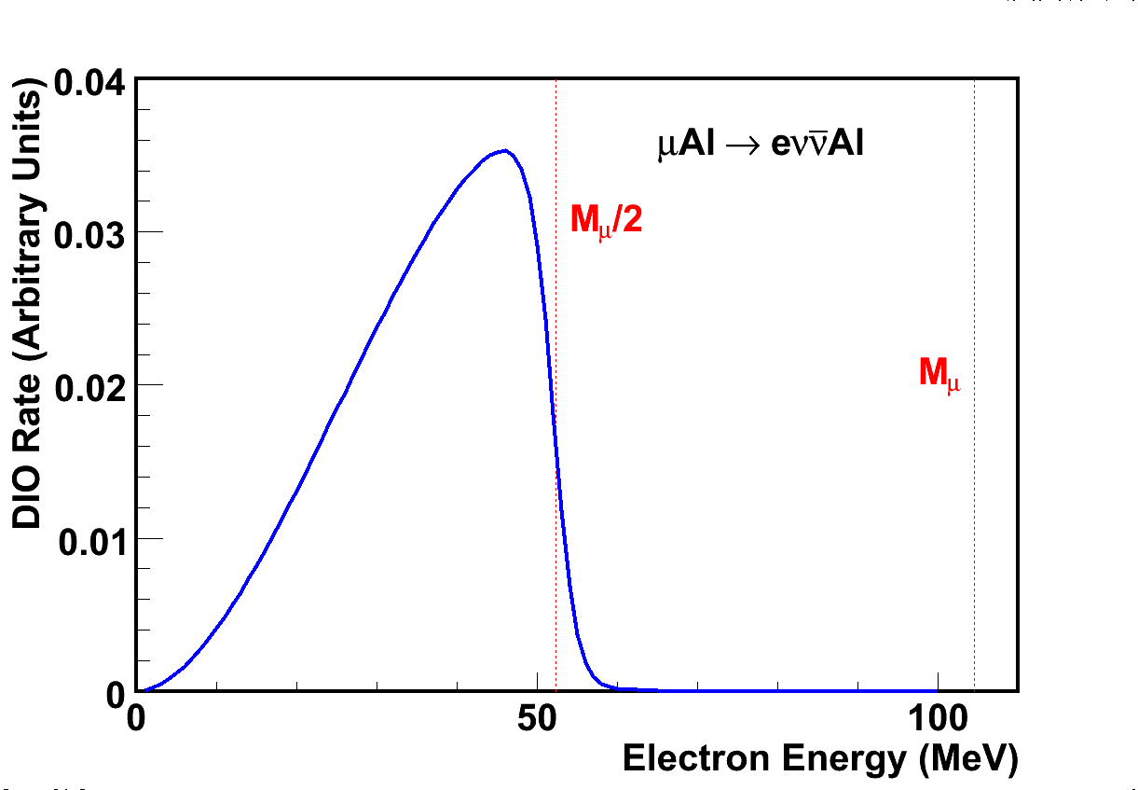
Your tracker is shaped like a long doughnut, that’s weird.
No hits in detector
Some hits in detector.
Tracks not reconstructable.
Beam’s-eye view of Tracker
Reconstructable tracks
Momentum resolution σ < 180 keV/c
Mu2e Collaboration, November 2013

Slide 15
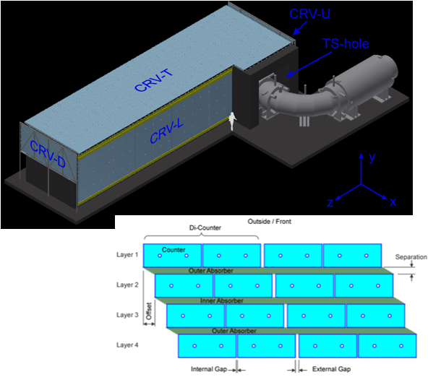
Don’t you have to worry about those pesky cosmic rays?
The CRV covers all of DS and half of TS
Without CRV, expect ~1 cosmic-ray-induced background event per day (99.99% net efficiency)
The CRV consists of 4 layers of scintillator strips with wavelength shifter and aluminum absorber
Mu2e Collaboration, November 2013

Slide 16
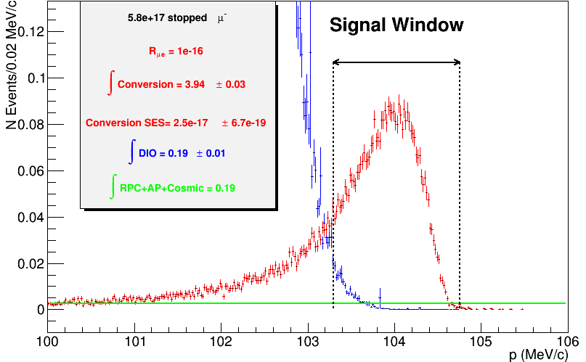
What do you hope to see after the 3 Year Run?
Stopped μ: 5. 8 × 10¹⁷
For R = 10⁻¹⁶
N_{μe} = 3.94 ± 0.03
N_{DIO} = 0.21 ± 0.09
N_{Other} = 0.16
SES = (2.5 ± 0.1) × 10⁻¹⁷
Errors are stat only
Mu2e Collaboration, November 2013
Reconstructed e⁻ Momentum

Slide 17
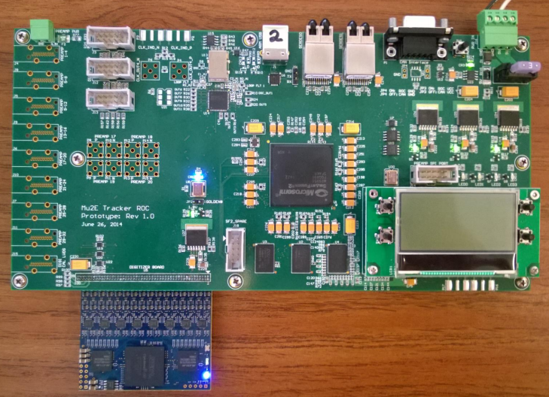
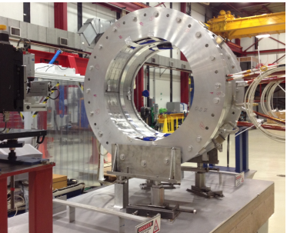
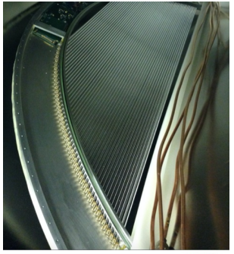
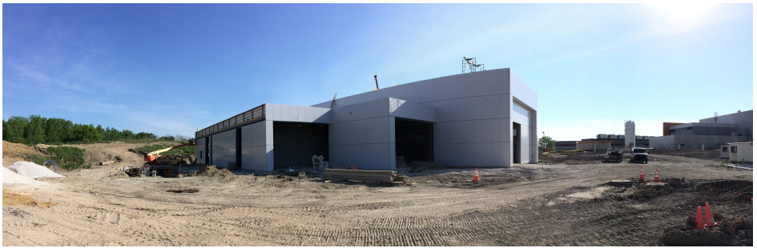
When is this all going to happen?
Construction is under way and our CD-3c review is happening right now in the HR.
We expect to be taking data in 2021.
Mu2e Collaboration, November 2013

Slide 18
Summary
There is a lot of excitement about theoretical model discrimination afforded with a 4 orders of magnitude improvement on muon conversion sensitivity.
The Mu2e project has a design which will allow for a single event sensitivity of 2.5×10⁻¹⁷.
Mu2e will be taking data in 2021.
Gee, you sure ask a lot of questions, lets give some else a turn.
Questions?

Slide 19
Thank you

Slide 20
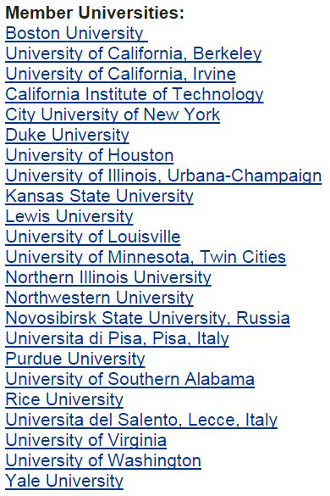
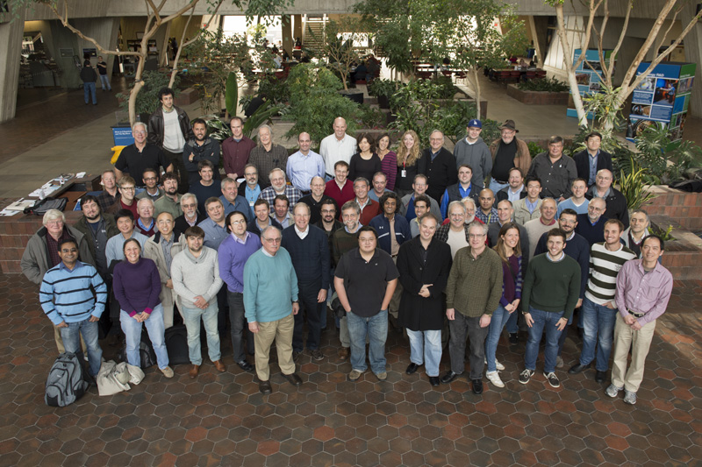
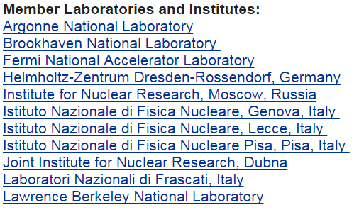




The Mu2e Collaboration
~200 members
33 institutions
4 countries

Slide 21



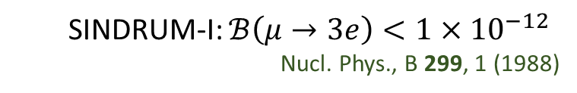


Current Worlds best measurements
$$μ→eγ$$
$$μN→eN$$
Muon conversion in the field of a nucleus
MEG: $ℬ\left(μ→eγ\right)<5.7×{10}^{−13}$
PRL 110, 201801 (2013)
$$μ→eee$$
SINDRUM-II:
EPJ C 47, 337 (2006)
$$\overline{e}$$
  SINDRUM-I: $ℬ\left(μ→3e\right)<1×{10}^{−12}$
  Nucl. Phys., B 299, 1 (1988)

Slide 22
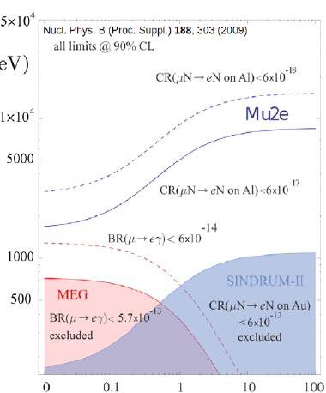
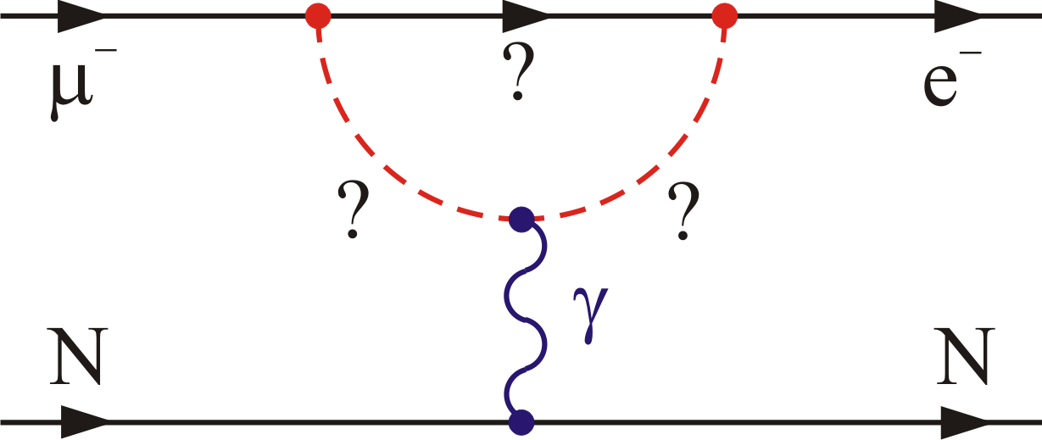
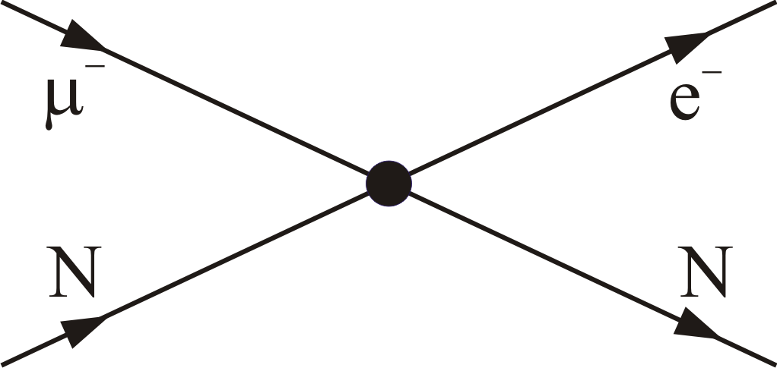
Sensitivity to High Mass Scales
Loops dominate for κ << 1
Contact terms dominate for κ >> 1
Λ (TeV)
μ→eγ
μ→eγ
μN→eN
μN→eN
μ→eee
μ→eee
Mu2e Collaboration, November 2013
κ

Slide 23
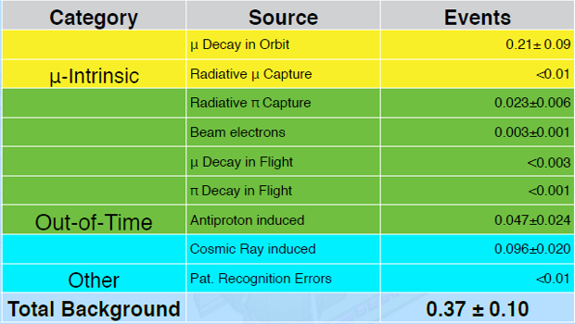
Mu2e backgrounds
*Assuming 6x10¹⁷ stopped muons in 6x10⁷ sec of beam time
Less than 1 background event allows us to reach desired single event sensitivity
Mu2e Collaboration, November 2013

Slide 24
Mu2e is High Priority for US HEP
In the 2008 P5 report Mu2e was strongly supported:
  “Mu2e should be pursued in all budget scenarios considered by the panel”
In 2010 P5 reiterated their support of the 2008 plan and the priorities specified therein.
In 2013 the Facilities Panel gave Mu2e the highest endorsement:
  “The science of Mu2e is Critical to the DOE OHEP mission and is Ready to Construct.”
In the 2014 P5 report Mu2e is strongly supported:
  Recommendation 14, “Complete the Muon (g-2) and Mu2e Projects.”
Mu2e Collaboration, November 2013

