Slide 1
Stuff I brought back from Fermilab
20+ troughs for epoxing straws
13 straw clamps
5 CO₂ readers
5 termination endpieces
4 barcode scanners
~1000 straws

Slide 2
13.
Initial Storage
Load Pallet on Cart
Remove paper, Conductivity Test
Epoxy CO₂ ends
Epoxy cure storage
Pressurize straws, Leak test
Laser Cut 1
Laser Cut 2
Detach Cut straws
Epoxy termination pieces
Cure epoxy
Termination Conductivity Test
Package for shipping
1.
9.
10.
2.
11.
8.
3.
7.
12.
4.
5.
6.
Tented
Suit Up Area

Slide 3
To make this outline happen?
Needs:
Tables
Storage areas
Remove current work benches
Remove/store current equipment
Tape out room, make sure this fits

Slide 4
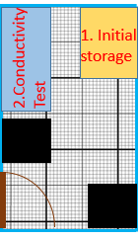
Initial Storage
Receive large plastic tubes with ~1000 straws each
Storage ~5 feet long with another 5 ft to safely pull the straw directly out.
These can be built out of Unistrut for a solid clean and sturdy fixture.

Slide 5
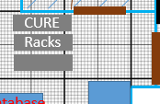
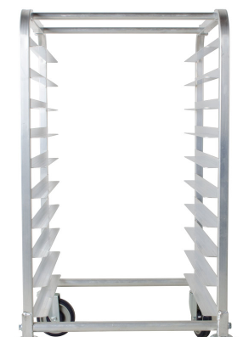
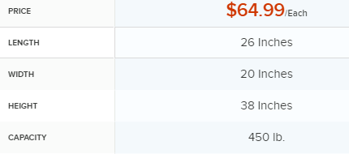
Straw Storage
Need 2 racks back to back to store 10 pallets
$65 a piece so $130 or $260 total
Loadable from either side
Centralized in room for ease of access
Add
Safety
notches
Remove wheels
Replace bars for required distance

Slide 6
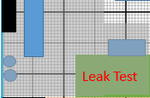
Leak Testing
Straw Prep Table
We don’t want to have to tip the chambers to get the straws out.
Think of implementing a loop and hook at the end of plastic tubes.
Computer
Gas cylinders

Slide 7
Pallet loading, Conductivity Test
Large table
Put straws into pallet
Barcode scan straw batch and pallet
Remove paper
Test conductivity
Leaves room for storage til epoxy

Slide 8
Pallets
Look at CAD drawings

