Slide 1
Electrostatic Tray

Slide 2
Introduction
During panel assembly, we face an issue of keeping the bottom straws in place while dragging the top straws over. Weight of end piece pushes the bottom straws to the sides and the top straw that we are dragging sinks in between.
The purpose of the ES tray is prevent that form happening while minimizing the risk of damaging the straws.

Slide 3
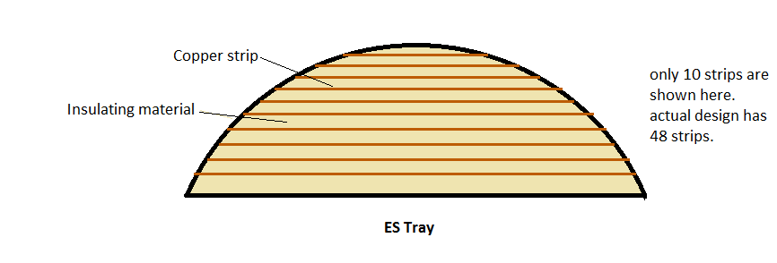
Design of ES Tray
the tray will extend under the straws area of the panel only.
The tray is shown in the figure.

Slide 4
Side View of ES Tray

Slide 5
Procedure
A clear thin layer of plastic is placed on top of ES tray. It acts as an insulator between a straw and the copper strips that runs underneath it.
All bottom straws will rest on the tray before charging.
The tray is then connected to a power supply to put it at positive high voltage.
The bottom straws will lock in place due to electron moving closer to the strips.
The force between the straws and strips will increase as the voltage increases, but not linearly.

Slide 6
Side View of ES Tray The copper strips are shown to be sticking out of the tray for convenience. They are still engraved in the tray body

Slide 7
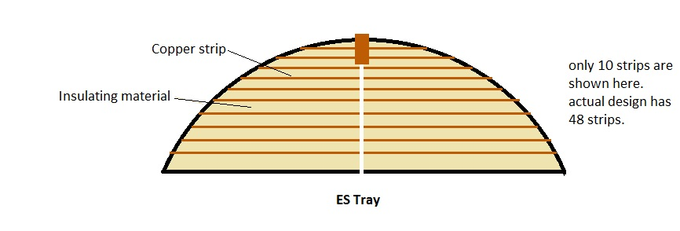
Notes
The ES tray we are using is cut in half. It was originally design for a different set up. The two halves are connected by a wide strip of copper.

Slide 8
Experiment
Specifications
The mass of the end pieces range from 0.823g-0.833g. End piece used was greater than 0.833g. It was also coated with our mylar to accurately mimic the conditions in the assembly process .
We used 4 different masses to see how much can a certain voltage carry (end piece, 3.090g,3.184g,10g). Our choices were limited when it came to masses.
The 3.090g and 3.184g masses length is about 5 times less than the length of the end piece. The force was more concentrated. 10g mass had a comparable length to the end piece.
We added a 18 MΩ resistor for safety.

Slide 9
Set up

Slide 10
Data
Voltage (V) | End Piece | 3.090g mass | 3.184g mass | 10g mass
100 | No | No | No | No
200 | No | No | No | No
300 | No | No | No | No
400 | No | No | No | No
500 | Yes | No | No | No
600 | Yes | Yes | Yes | No
700 | Yes | Yes | Yes | No
800 | Yes | Yes | Yes | No
900 | Yes | Yes | Yes | No
1000 | Yes | Yes | Yes | No
1500 | Yes | Yes | Yes | No
2000 | Yes | Yes | Yes | Yes
2500 | Yes | Yes | Yes | Yes

Slide 11
Notes on Safety
We checked the value of the average human body as a resistor, It’s 100KΩ. Our resistor is 18 MΩ. So the current drawn without a limiter for the highest voltage (most dangerous) possible with our power supply would be
$$I=\frac{Voltage}{Resistance}$$
$$I=\frac{2500}{18.1∗{10}^{6}}=0.138 mA$$
The voltage drop across the human body in these conditions is only 13.8 V.
Our limiter is set to 0.01 mA and the trip is 1 mA and can be set to 0.1 mA after turning on the supply. During operation the voltage drop across the human body is 1 Volts and in worst case scenario it is 10 Volts.
We had gloves and wore normal shoes on. We were able to touch the ES tray with only the thin plastic layer in between without any pain.
At 2 mA we felt a slight tingling sensation at our finger tips.
We believe the set up is very safe when operating at 2500 V.

Slide 12
Ideas for current design and next design
Any ideas for current design?
Next design will be similar except it will have the copper strips alternate between positive voltage and negative voltage. Ideas?

