Slide 1
Code Management With Github & Straw Resistance Measurements
7 July, 2017

Slide 2
Github: Getting Started
Github allows access to view and edit all python scripts, Arduino code, data files, etc from any computer
Looking into automating this to send data from each station to Dan Ambrose each day.
Anyone currently working on scripts, please find me so we can discuss the best way to include necessary files in repository
When accessing and editing files, repository works just like a typical folder on a computer
To pull in updates and send changes to the master branch of the repository (hosted on Github.com), run commands in Git Bash
Anywhere in local repository folder (Mu2e-Factory on the desktop of computers in PAN464), right-click, select “Git Bash Here”

Slide 3
Github: Important Commands (preceded by git)
pull : takes changes from repository and puts them on local machine (ALWAYS PULL BEFORE RUNNING ANY OTHER COMMANDS)
status : shows any local changes that vary from repository (do this after making a change)
add : any files or folders included in this line are set to be merged into repository (use add -A to add all changed files in repository)
commit –m “EXPLAIN CHANGES” : locks in changed files
push : merges committed files with master branch
At this point, any other computer running the command git pull will now have your changes

Slide 4
Github: Getting Repository
Send an email to kampa041@umn.edu with your github username or email for access to make changes to repository
Download and install git: https://git-scm.com/downloads
Use recommended install settings
In folder where you want repository, right-click, select “Git Bash Here”
$ git clone clone https://github.com/ckampa13/Mu2e-Factory.git
$ cd Mu2e-Factory/
$ git config user.email “GITHUB_EMAIL”
$ git config user.name “GITHUB_USERNAME”
When you first push from your computer, you will be prompted to enter your Github username and password

Slide 5
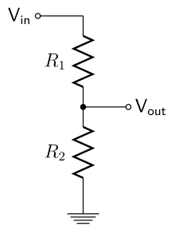
Straw Resistance Measurements: Ohmmeter
Using a voltage divider with a known resistor R2, R1 can be determined by measuring the output voltage
$$V_{out}=V_{in}∗\frac{R_{2}}{R_{1}+R_{2}}$$
$$R_{1}=\frac{R_{2}\left(V_{in}−V_{out}\right)}{V_{out}}$$

Slide 6
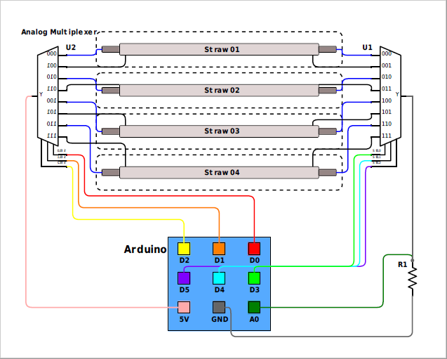
Straw Resistance Measurements: Circuit Design
Using all 6 analog inputs, A0-A5, number of measurement cycles reduces from 96 to 16
Op-amp voltage follower (buffer) is needed at each 5V input of a module to isolate voltage dividers
The same digital outputs can be used on all 6 modules of circuit
Allotting 3 seconds per measurement cycle (for fluctuations), the entire pallet is measured in under 1 minute
By hand: 1,375 hours (45min/pallet with 2 people)
Automated: 30 hours (2min/pallet with 1 person)
R2
Buffer

Slide 7
Resistance Measurements: To Do
Currently designing PCB
Consistent and quick method for calibration (every month or two?)
Non-zero on resistance of analog multiplexers requires proper calibration
Voltage divider consistently reads 17.5% below real value for resistances in the range of 1Ω-5k Ω (this has been adjusted for, but can it be explained?)
Connections to straws
Inside: End pieces with wire soldered in and round off resting in 3D printed pallet edge pieces –Need to produce 48 (+extras)
Outside: Currently looking into designing a clip with conductive foam to add onto existing inside measurement piece
Calibration

