Slide 1
Indiana Group Data Processing Update: Feb 25, 2016
Gary Pavlis

Slide 2
In this powerpoint
S wave velocity results from 2000 level land streamer data (James Atterholt – freshman undergrad)
Progress on catalog development
Worked on tuning automated detectors
Reviewed results from 8 days in May 2015
Show examples
Wyoming mining explosions (dominant events detected)
Teleseisms
Blasts from gold mine directly west of Lead
Weird noise located inside array (probably construction on main street in Lead)

Slide 3
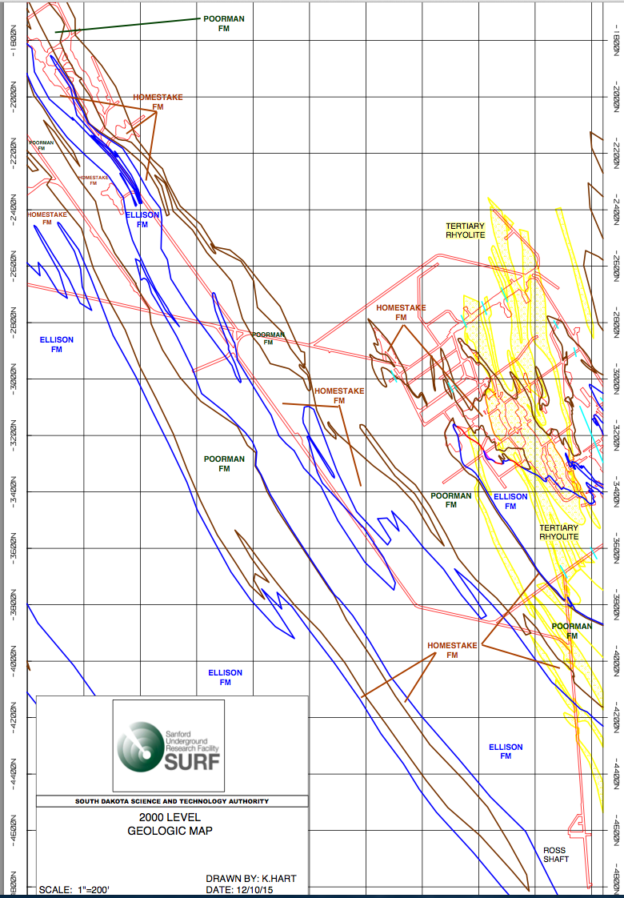

Slide 4
Pure Homestake – section 1
Average: 3404 m/s

Slide 5
Pure Homestake – section 2
Average: 3426 m/s

Slide 6
Ellison Formation
Average: missing from spreadsheet about 3300 m/s

Slide 7
Mixed lithology section – near Ross
Average: 3729 m/s

Slide 8
Catalog preparation
51 local-regional events
In 8 days
Note: these are only no brainers
Array
Mislocated events

Slide 9
US regional and teleseismic events
17 events in 8 days – 3 US regionals, 14 teleseisms

Slide 10
Wyoming mining event

Slide 11
Local (gold mine) explosion

Slide 12
Regional - oklahoma

Slide 13
Teleseism - intermediate depth event from Chile

Slide 14
Local event (inside array)

