Slide 1
Search for solar normal modes in ambient seismic noise
Ross Caton & Gary L. Pavlis
Indiana University

Slide 2
Background
Earth’s “hum” was first found in the 90’s (Suda et al. 1998)
Suggested mechanisms
Atmospheric turbulence (Suda et al. 1998)
Ocean forcing (Watada & Masters 2001)
Solar forcing (Thomson et al. 2007)
Some peaks have very high Q
Oceans cannot excite toroidal modes
Likely a combination

Slide 4
Motivation
Such long-period hum studies have been done before, as in Thomson & Vernon (2015), but these used a single station per spectrum
We attempt to improve upon this by using an array of stations
Noise reduction from beamforming
Jackknife statistics

Slide 5
Data
We need very quiet data to detect these low-SNR signals
Underground array of 15 broadband seismometers in Homestake mine (now Sanford Lab) in Lead, SD
Depth ranges from 300 to 4850 feet underground
Extremely quiet, isolated from weather & diurnal temperature fluctuation
Aperture of ~1 km

Slide 6
Data
We also need long time series to get adequate line resolution
Two subsets of these data:
58.5 day segments, 2 earthquakes M ≥ 7.0
205 day segments, 12 earthquakes M ≥ 7.0

Slide 7
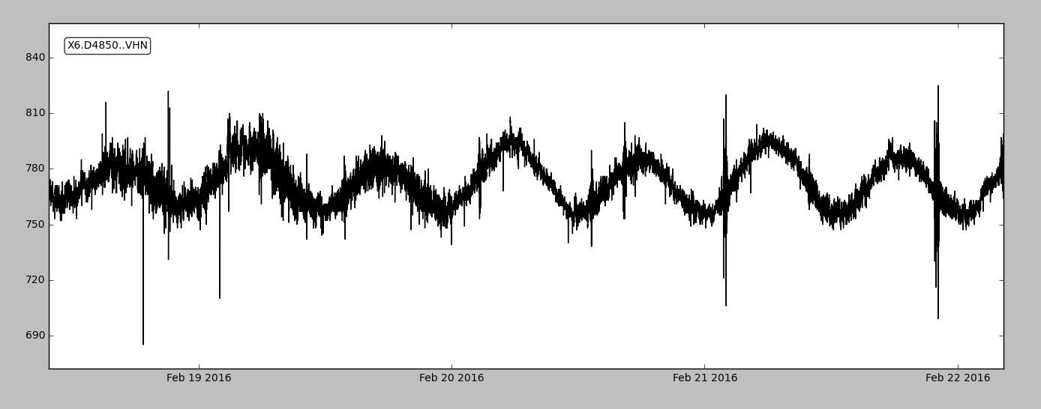
Data

Slide 8
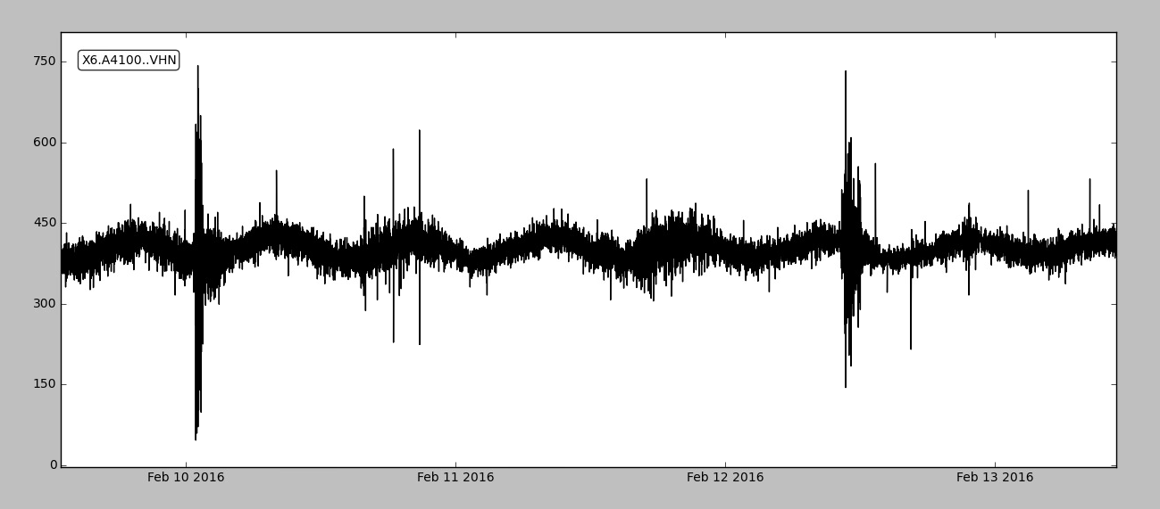
Data

Slide 9
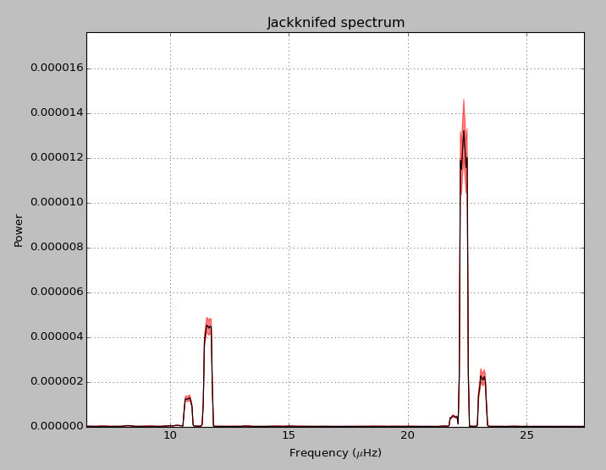
Data

Slide 10
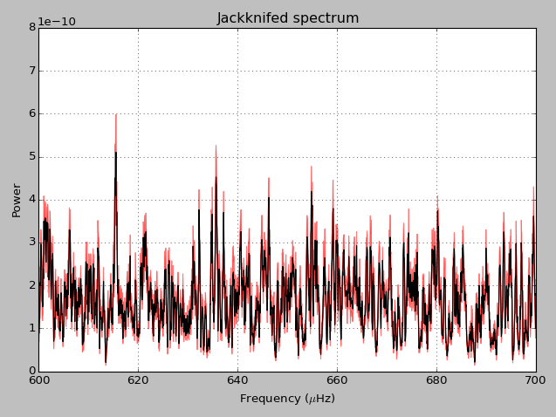

Slide 11
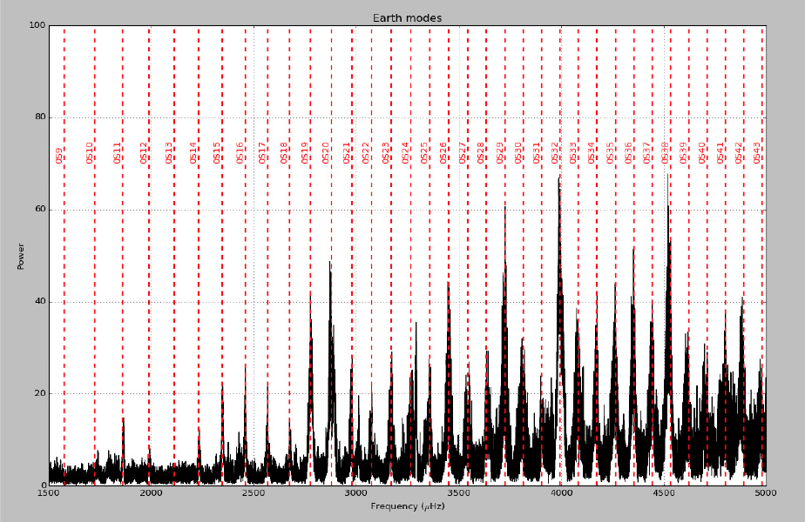

Slide 12
Processing steps
Filter transients
Autoregressive prewhitening
Form robust beam
Multitaper spectrum
Spectrum standardization
Estimate distribution

Slide 13
Multitaper spectrum estimates
The multitaper estimator has low variance, bias, and leakage
Estimate several PSD (called “eigenspectra”) using the Slepian tapers
Slepian tapers maximize the amount of power within a specified bandwidth
Take a weighted average of these estimates to reduce variance
(Thomson 1982) for details

Slide 14
Transient filter
Earthquakes, mining blasts, mass recenters, and sensor glitches add undesirable harmonics to the spectrum
(Optional) Standardize time series data with robust measure of scale
At each point, check if it’s value exceeds a given threshold
If it does, replace with trimmed mean of surrounding points

Slide 15
Transient filter

Slide 16
Transient filter

Slide 17
Distribution fitting
It’s possible to statistically estimate the SNR and fraction of frequency bins of modes in a given band
Spectra of noise are central Chi-square distributed
Spectra of lines are noncentral Chi-square distributed
Do a grid search over non-centrality parameter and fraction of frequency bins in the noncentral distribution for the minimum D-statistic
(Thomson et al. 2001) for details

Slide 18
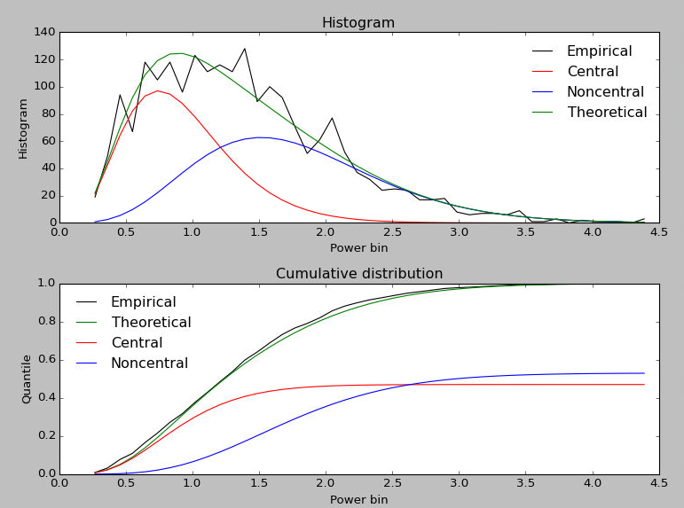
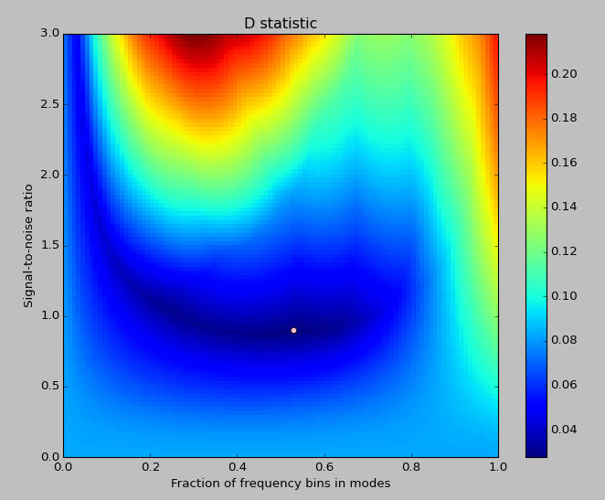

Slide 19
Spectrum standardization
We need to assess the significance of lines that we find
Power spectra are chi-square distributed
If K tapers are used, the standardized spectrum of white noise is approximately Gamma(K, 1/K) distributed
Divide the spectrum by it’s “base,” here estimated by ordinary least squares of the bottom 20% of bins
Scale so it’s 5% point matches the 5% point of a Gamma(K, 1/K) distribution
(Haley & Thomson) 2014 for details

Slide 21
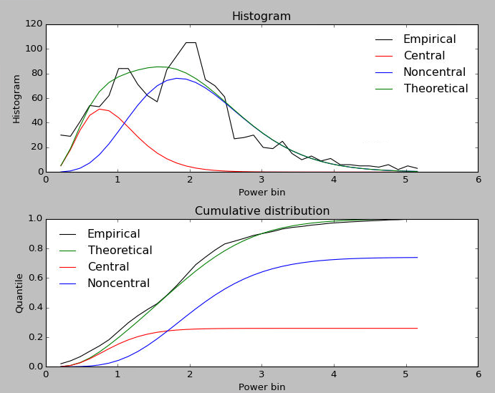

Slide 22
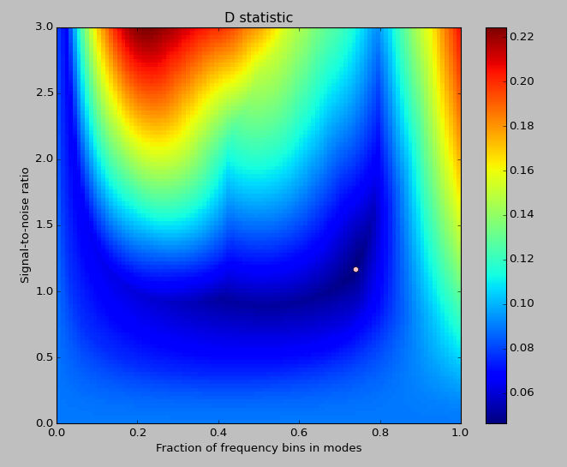

Slide 23
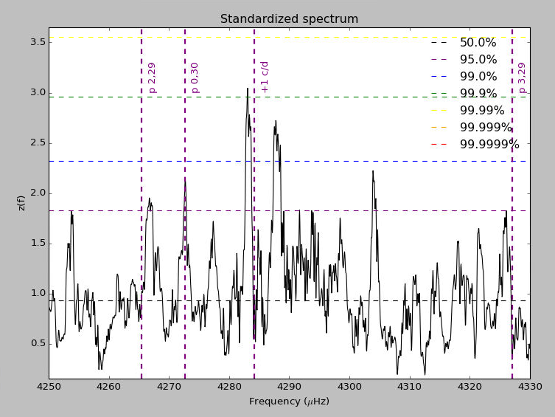

Slide 24
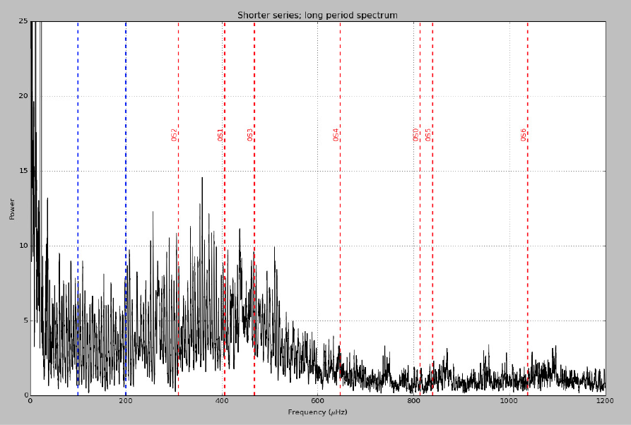

Slide 25
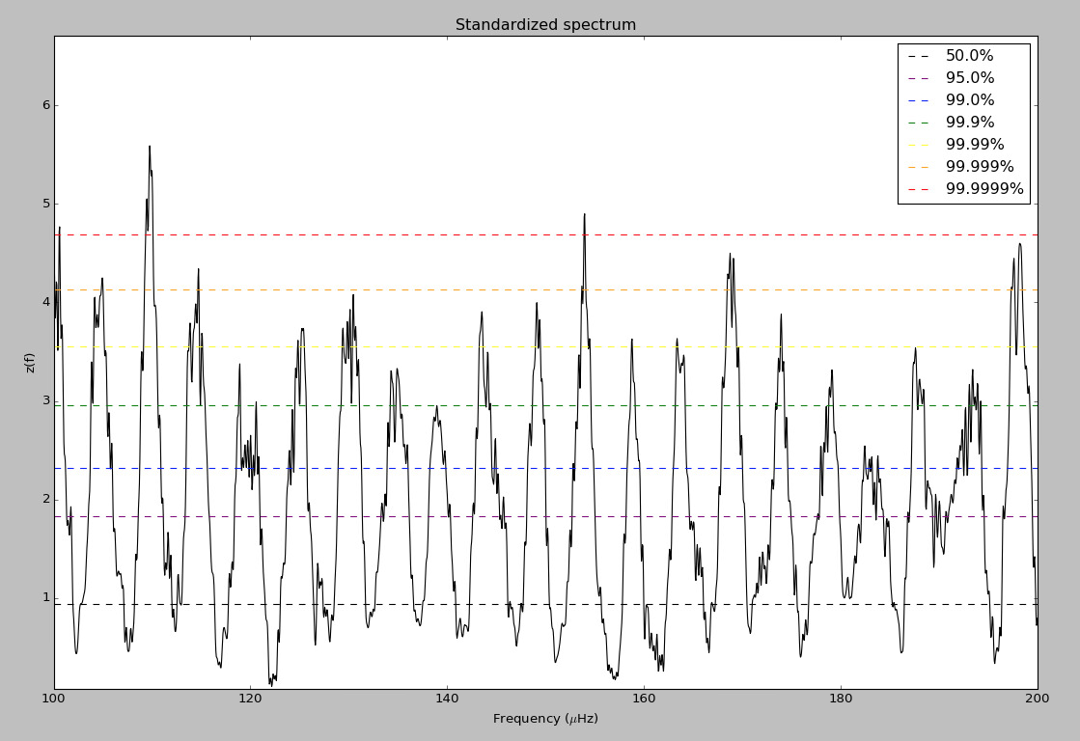

Slide 26
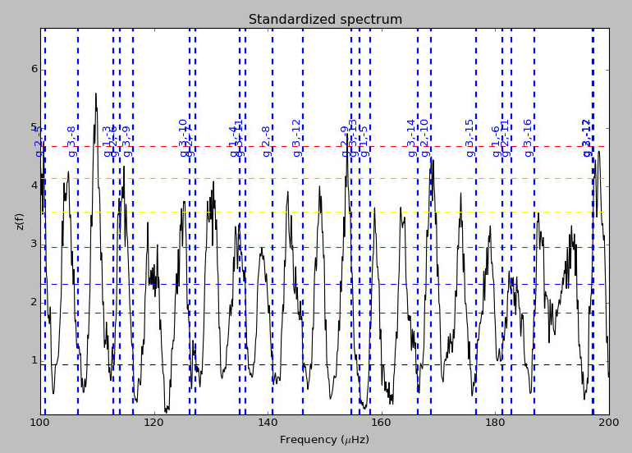
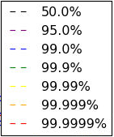

Slide 27
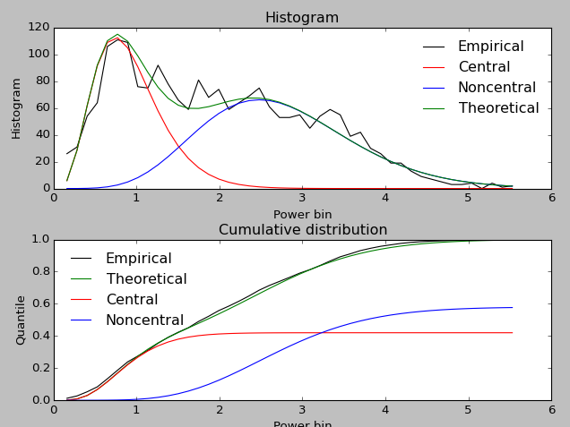

Slide 28
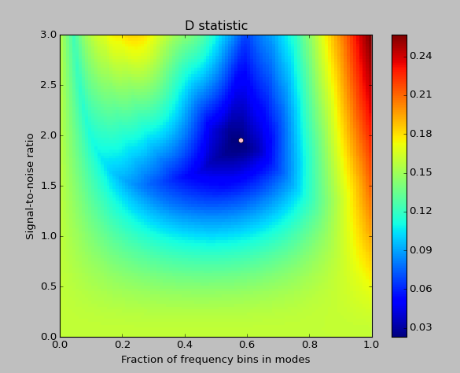

Slide 29
Conclusion
There is tentative evidence for p-mode frequencies within the seismic spectrum
The very long period band associated with g-modes is filled with lines
It is as of yet unclear if we are reducing the effective noise with beamforming

