Slide 1
Long period modes update
Ross & Gary

Slide 2
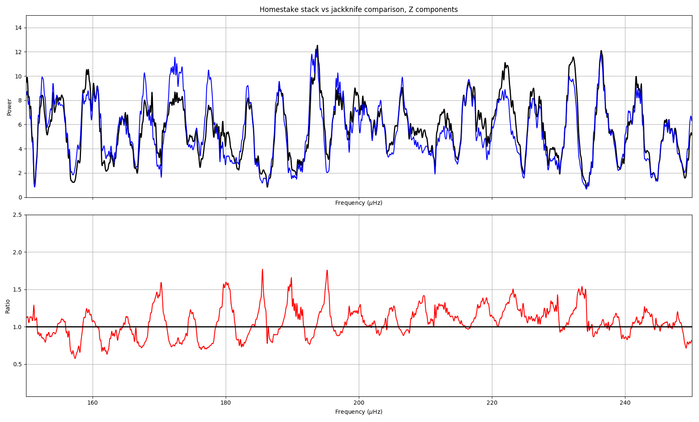

Slide 3
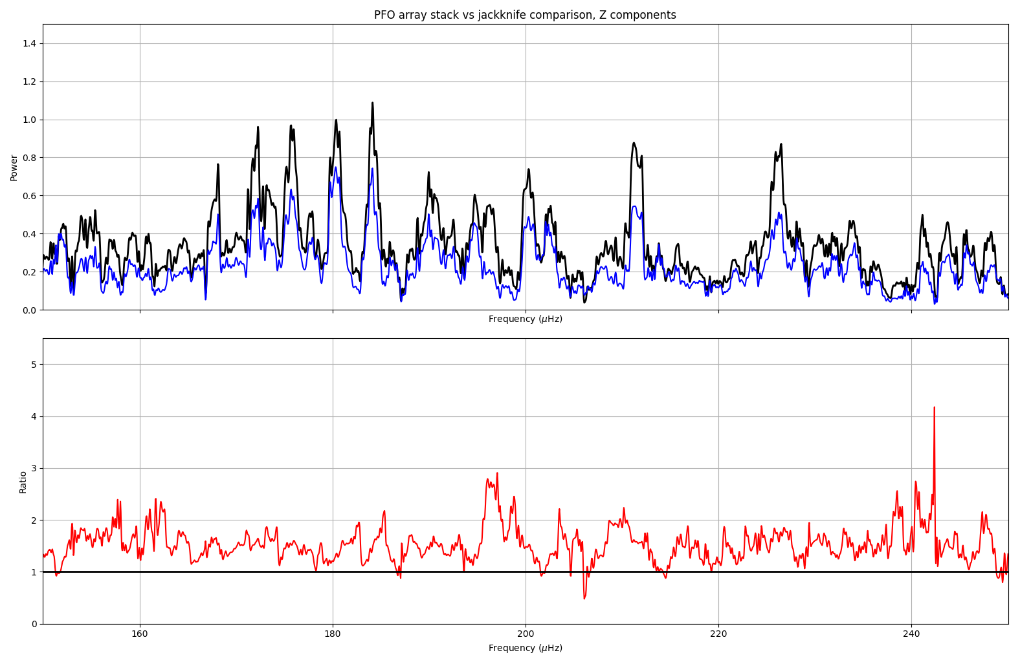

Slide 4
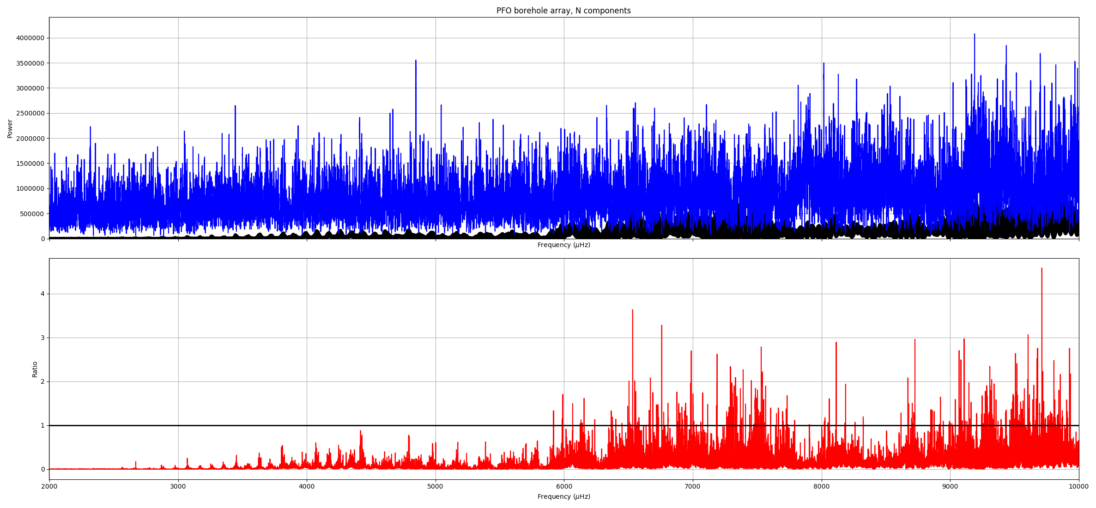

Slide 6
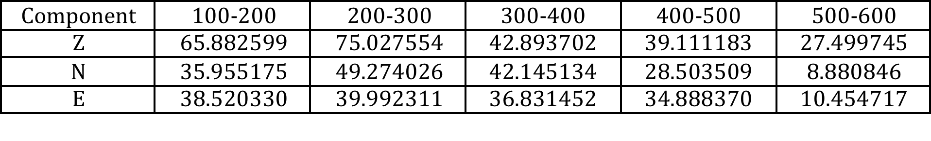
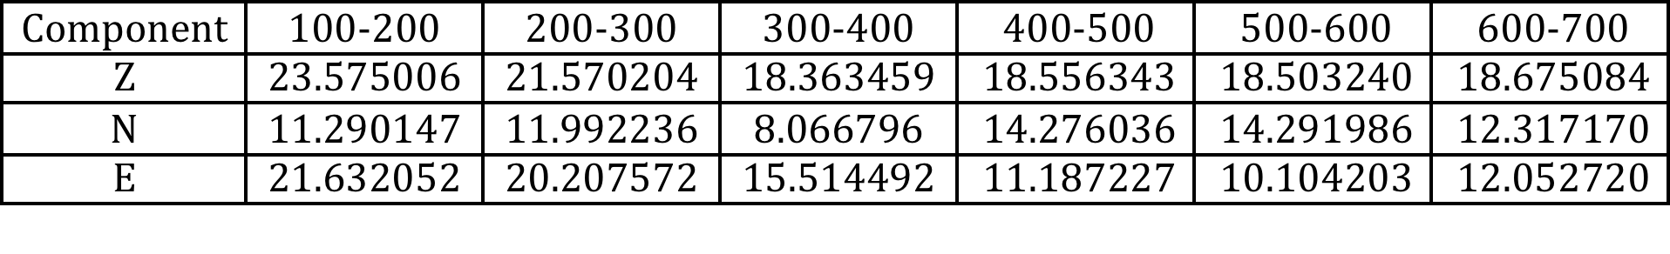
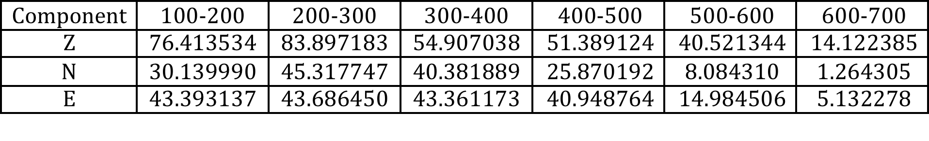
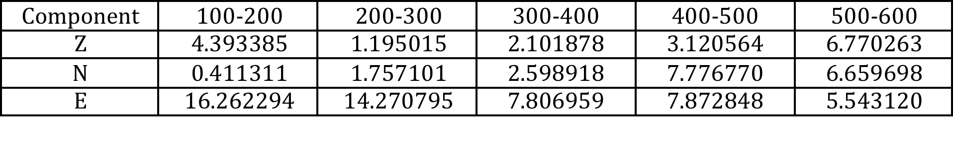
Table 1: D-statistics in various bands in HS spectrum, comparing to noise.
Table 2: D-statistics in various bands in HS spectrum, compared to 600-700 μHz.
Table 3: Same as table 1, but for PFO array.
Table 4: Same as table 2, but for PFO array.

Slide 8
Processing steps
Time-domain standardization
Transient filter
Linear detrend
AR prewhitening filter

Slide 9
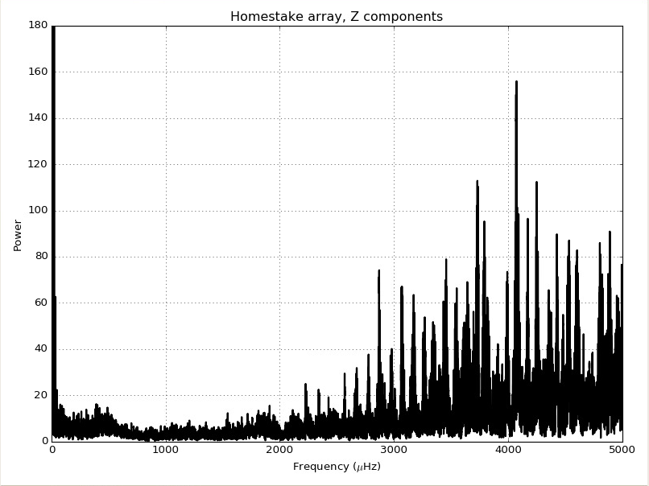
Notes:
All processing steps

Slide 10
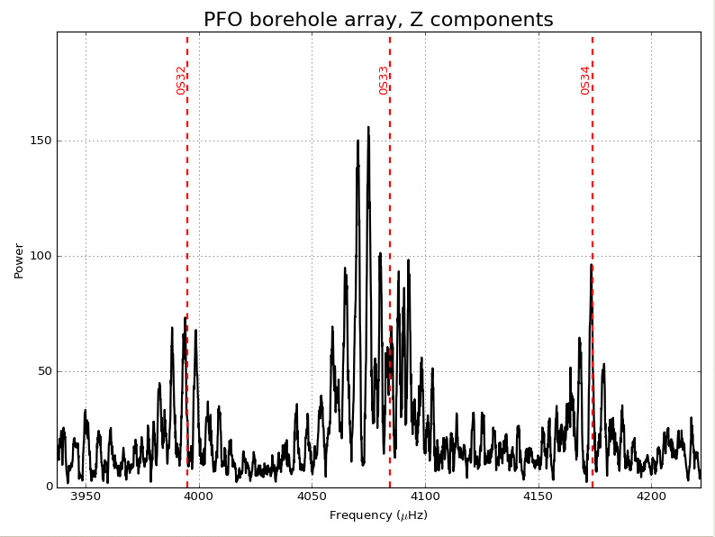
Notes:
All processing steps

Slide 11
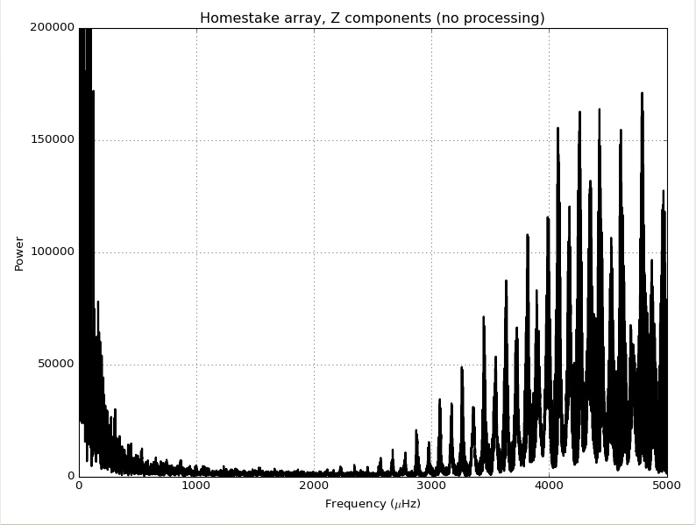
Notes:
No processing

Slide 12
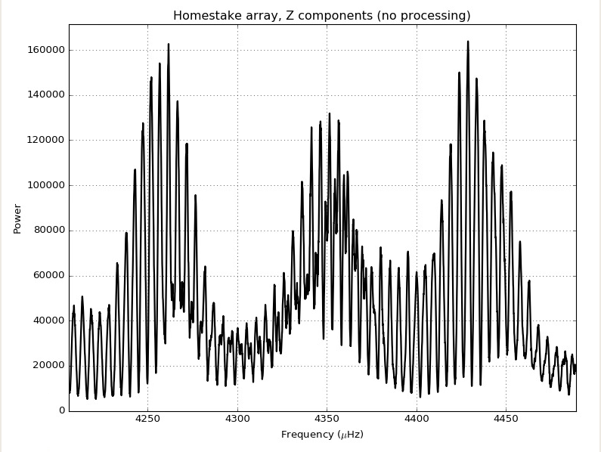
Notes:
No processing

Slide 13
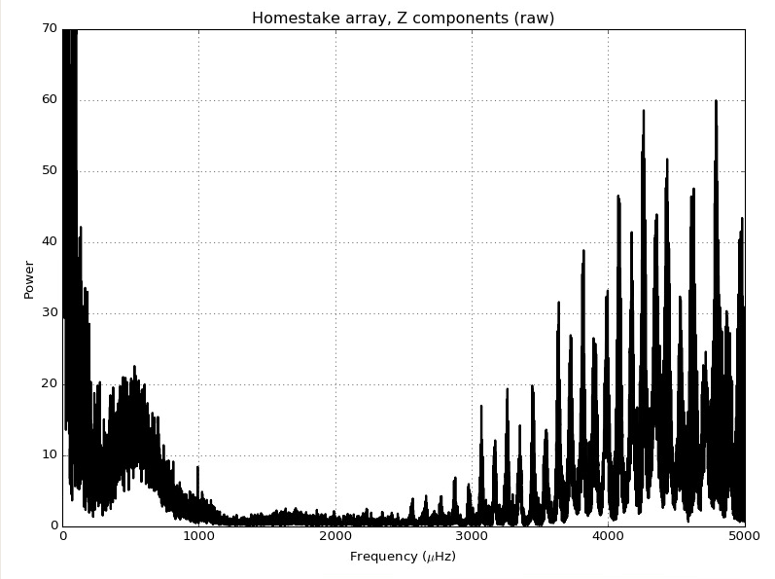
Notes:
Only standardization

Slide 14
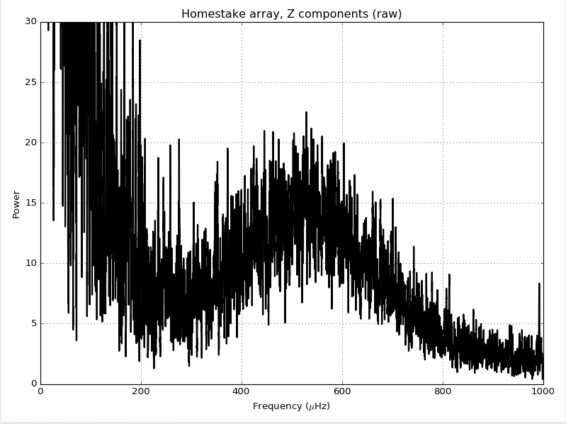
Notes:
Only standardization

Slide 15
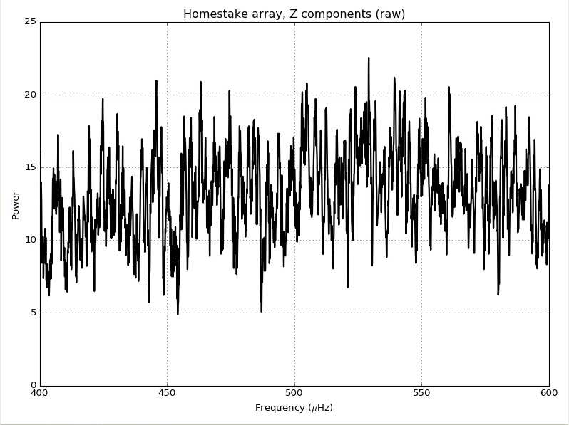
Notes:
Only standardization

Slide 16
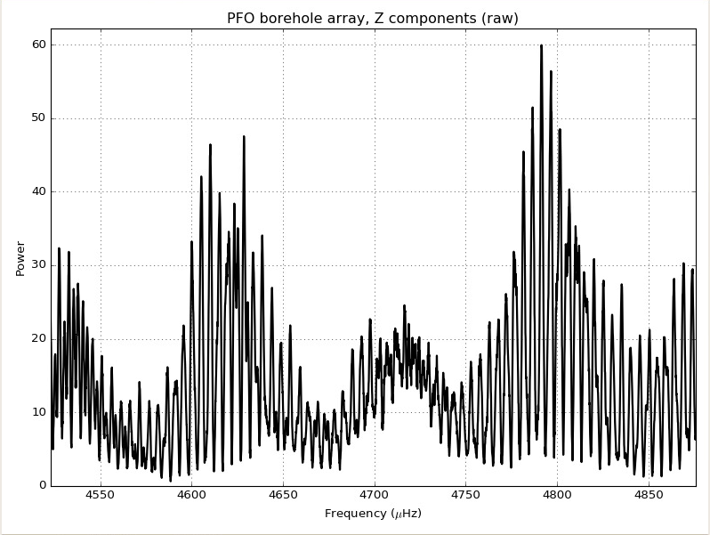
Notes:
Only standardization

Slide 17
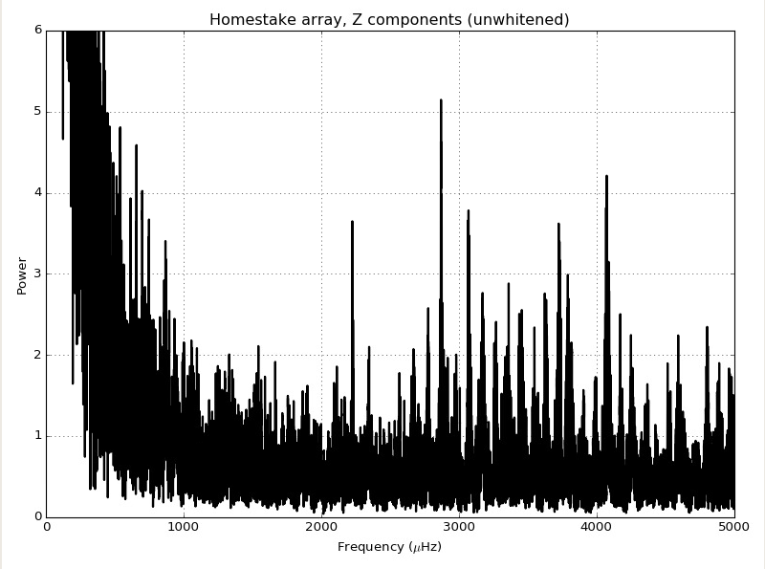
Notes:
Everything except AR filter

Slide 18
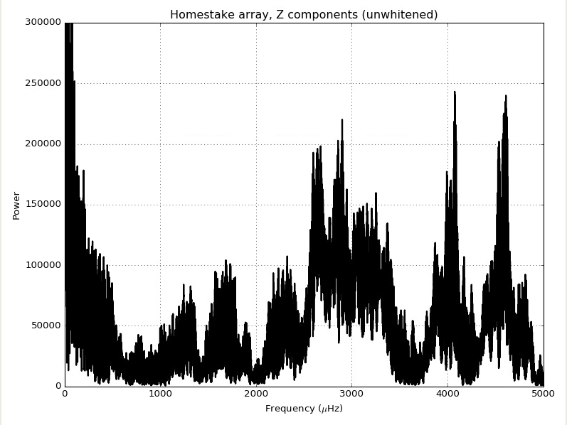
Notes:
Transient filter, detrend

Slide 19
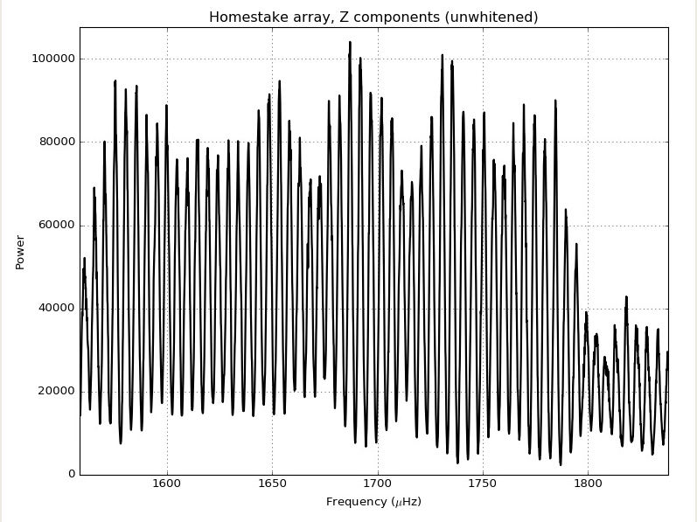
Notes:
Transient filter, detrend

