Slide 1
DUGL Weight Drop Source Data Analysis: Progress report
Gary Pavlis

Slide 2
Reminder of what was done
Boise State Land Streamer source drove over array with weight drop source
Data recorded at surface by their land streamer (will be useful for near surface structure)
For us aim was to provide travel time data to our underground sites
PROBLEM: timing system Boise State deployed failed

Slide 3
Fundamental Assumptions
Data recorded are Green’s functions for vertical point force at one position and at a given receiver (3C data)
Green’s functions for closely spaced shots are approximately equal (well established in seismology)
We have shot times to the nearest second – need to resolve subsecond correction
All our instruments have accurate absolute time

Slide 4
Basic concept
Cross correlation
  One or more pairs of data from shots within a limited distance separation
  Correlate each component on the same station
  Also do a 3C combined correlation
Multiple stations and channels between same pair of shots share a common delta time
Key issue is how to average them

Slide 5
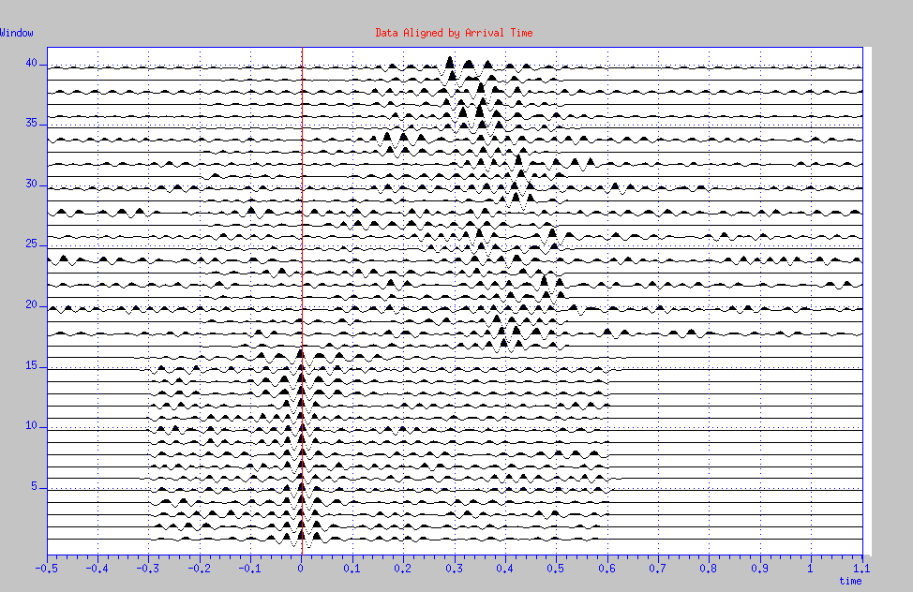
Concept and final working solution
Component Pairs Displayhed side by side
Cross correlation
functions

Slide 6
Current Program approach
Gather adjacent data from adjacent pairs of shots
Keep only data in intervals marked (separate step) as good
Display data and set rough initial lag
Compute component cr0ss-correlation functions
Compute 3C cross-correlation functions
Use median peak as secondary lag estimate
Display data as show in previous slide
GUI allows interactive shifting left or right
Save results to a simple text file

Slide 7
At the risk of boring you with my saga
Major algorithms I tried
  Robust average of multiple pairs over a fixed distance range (40 m max shot spacing) – total failure from small fraction of good data
  Filtered data – define time ranges were signals were visible at each station (became a component of final)
  Interactive picking of predetermined “best” station for each shot (final GUI a minor change from this)
  Current algorithm

Slide 8
Problems:
Small fraction of data had sufficient signal to yield any valid correlation
Narrow bandwidth – 25 to 40 Hz antialias corner – makes cross-correlation functions subject to cycle skips
Strong harmonic noise on several key stations in the band

