Slide 1
Homestake Surface Array Reconnaissance Report
Gary Pavlis

Slide 2
Overview
Trip of opportunity – family reunions in SD
At Sanford Lab June 30-July1
Accompanied by Tom Regan
Written reports on 8 locations for 6 sites (2 options for Ross and Yates)
Best to load Google Earth kmz file you should have received to go with next slides
Discuss Ross and Yates last
Discuss 3 outer station option

Slide 3
What you should see with Google Earth

Slide 4
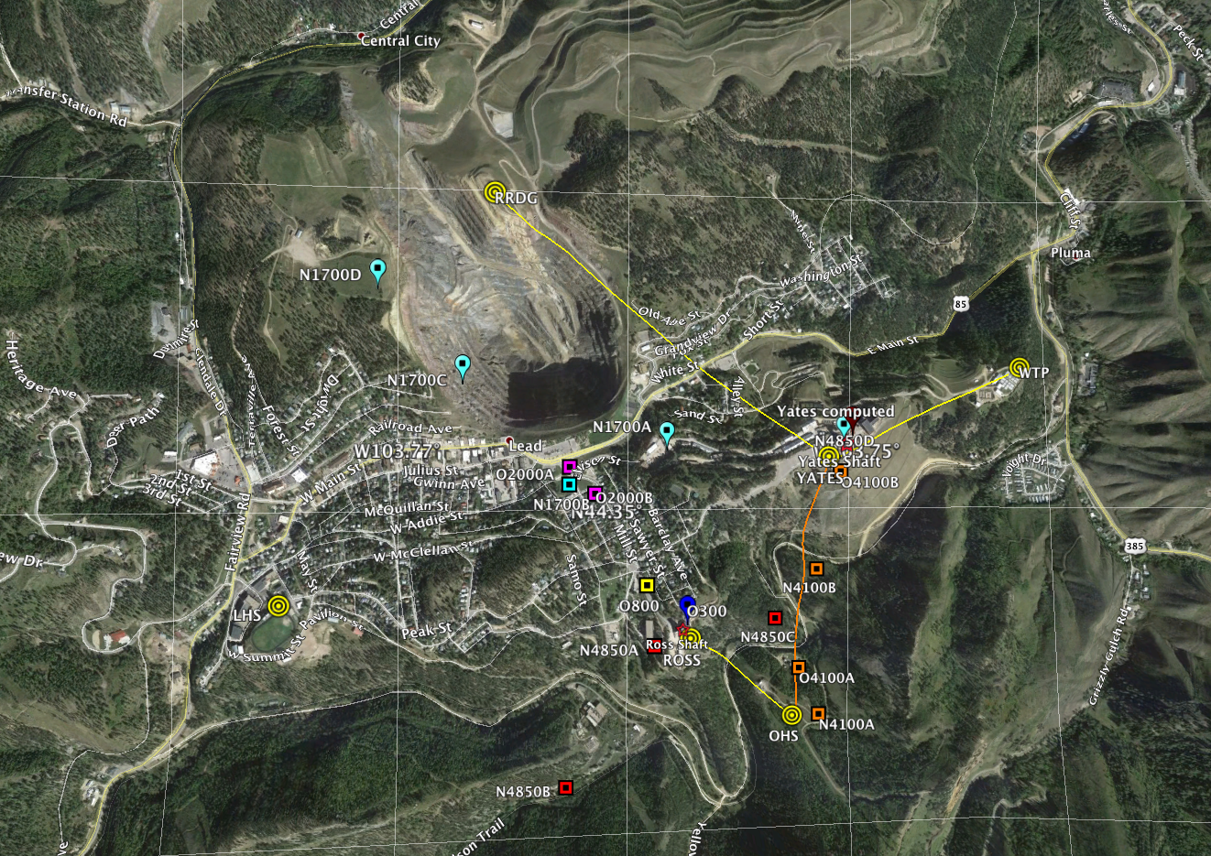
OHS – Oro Hondo Substation

Slide 5
OHS – Ross in background

Slide 6
OHS – Oro Hondo Substation
RF telemetry to Yates or Ross possible
Good site for solar
May be on up to 2 m of fill (unclear)
Lab property but road maintained by Barrick
Lab has easement for access and key

Slide 7
WTP-Water Treatment Plant

Slide 8
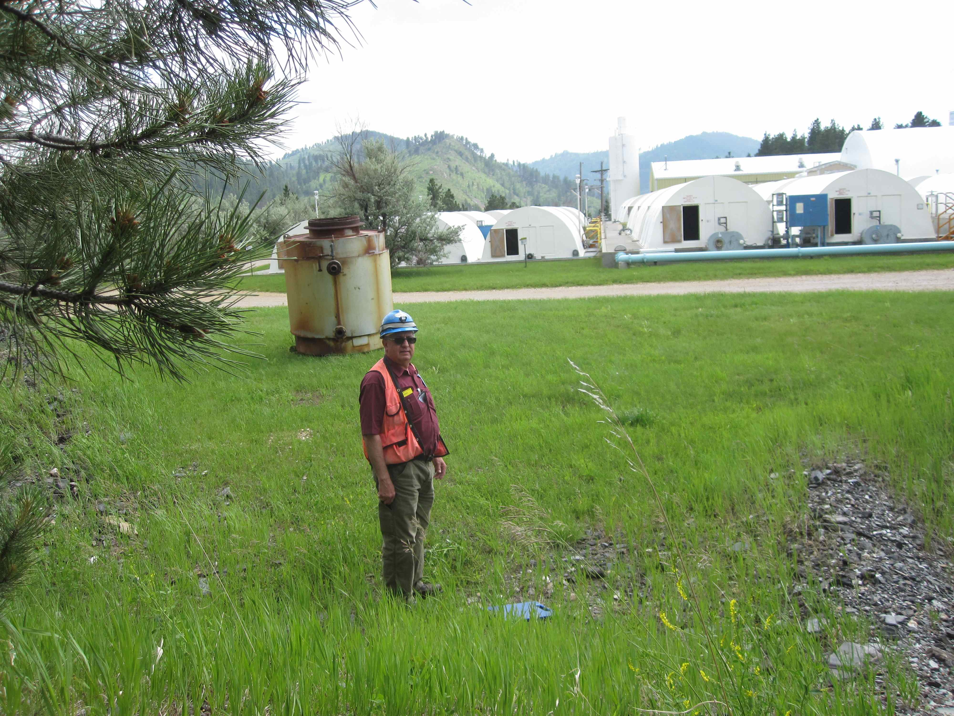
WTP – bad stuff in background Clear on other sides

Slide 9
WTP – Water Treatment Plant
Bedrock site
Good site for solar
At northeast edge of Sanford Property
Close to water treatment plant a problem, but all flat spots in area are impacted by people

Slide 10
RRDG – Rhyolite Ridge

Slide 11
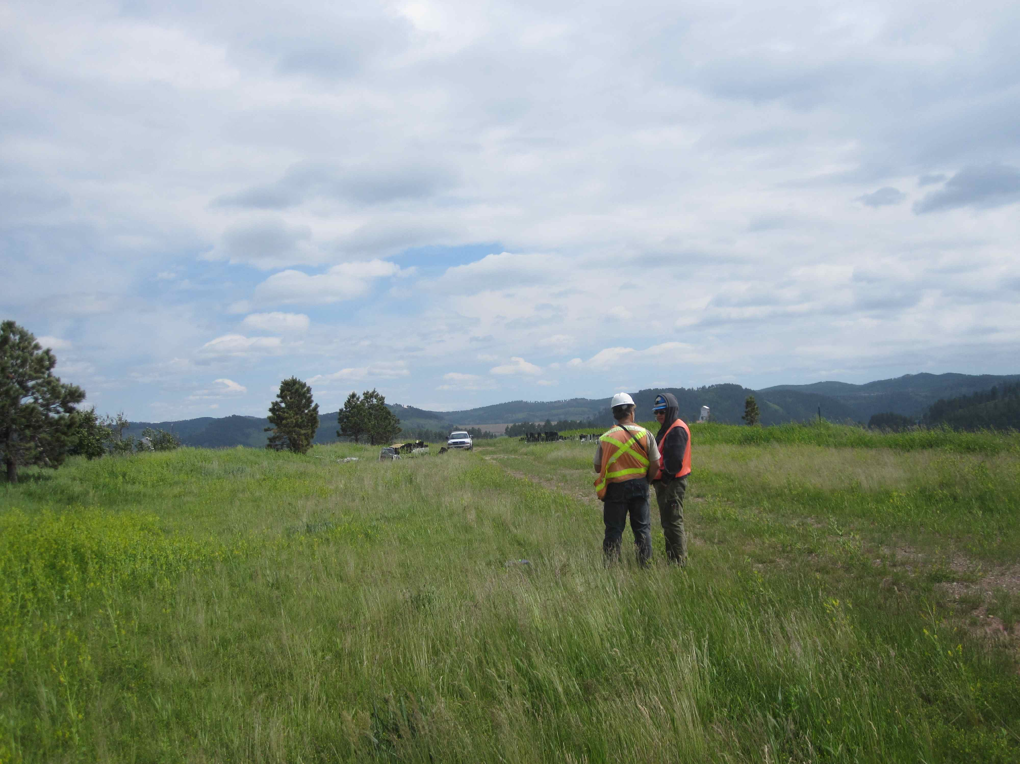
RRDB – Yates and Ross visible

Slide 12
RRDG - Rhyolite Ridge
At summit of peak on north side of open pit
Close to zero soil cover
Perfect line of site to Yates for RF telemetry
4WD road on Barrick property
Permit process in progress
Wind could be an issue here
Should be very quietest site of this set

Slide 13
LHS – Lead High School

Slide 15
LHS – Lead High School
Met with School Superintendent – very supportive
Expecting school board approval
Important local outreach activity – working on contacts with school science teachers
Planning student involvement in site prep and installation
Expect to run radio link from site to school internet
AC power – run 12 V line to site as shown in next slide

Slide 16
ROSS and YATES
Problems
Master GPS timing constraint
All that machinery
Parking lots
Discussion question
IRIS is willing to supply us with an extra Q330 we can use only for station master
Fair sites possible within 100 m or so of both shafts: recommend deploying ROSS and YATES sites there

Slide 17
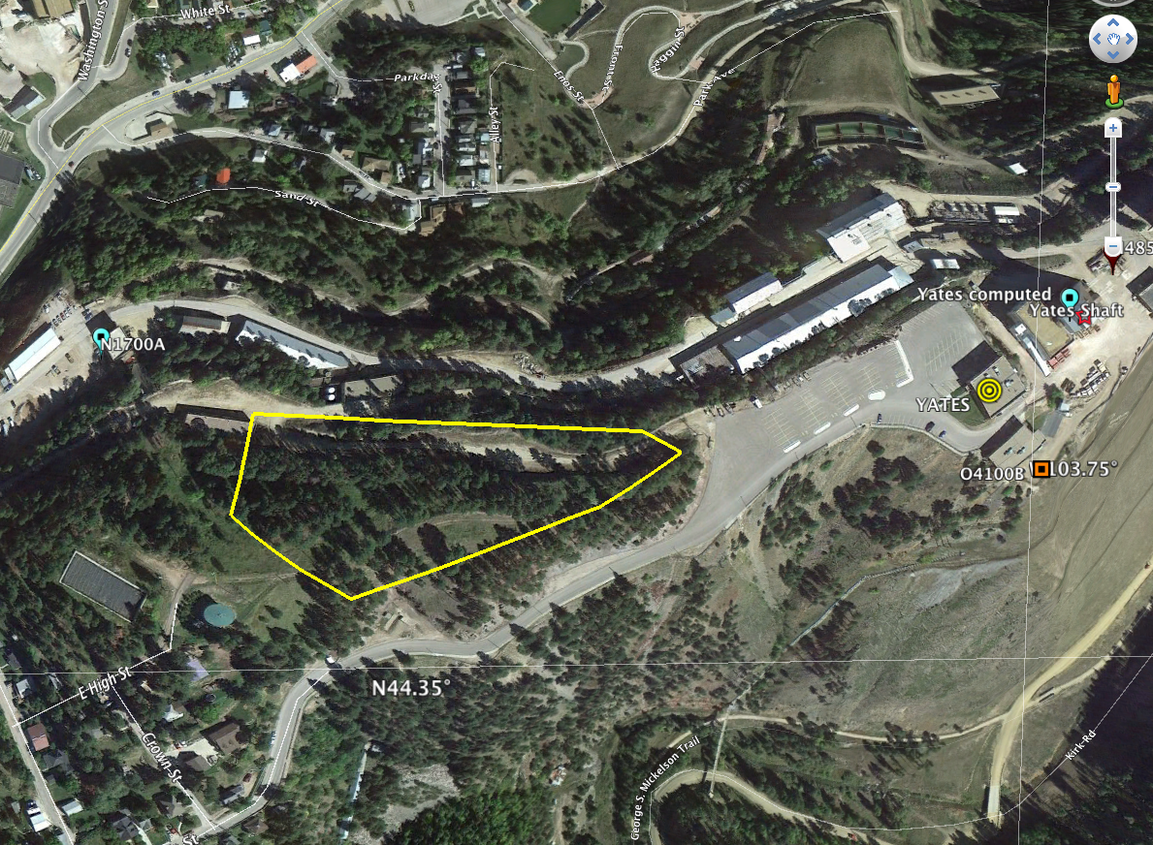
Yates Remote Option

Slide 18
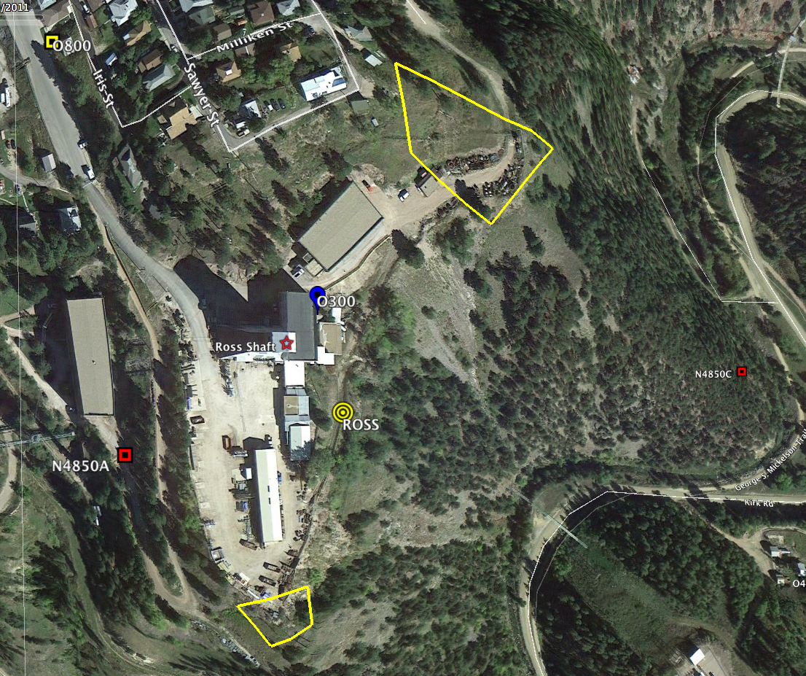
ROSS Remote Options
Added option today
Been here

Slide 19
Discussion 2: Outer Ring
Propose 3 outer ring locations (map next)
Needed for aperture for array processing
Can afford them with our budget
These would be standalone (not real time)
Record only to local disk
Download every 2 to 3 months
Had 1 hour to try to find sites
Found one landowner home, turned me down
County GIS site shows large fraction are summer or ski homes
Followup needed in Sept if we choose to do this

Slide 20
Where to put these?

