Slide 1
Weight Drop Data Analysis Status Report: Nov 3, 2016
Gary Pavlis

Slide 2
Status
Have first order shot time estimates for all data except the long line done on day 3
This is generally better than I once thought, but beauty is in the eye of the beholder
Examples in this powerpoint are all from “line100B – day1”
Left: shot near Yates headframe
Right: shot near Mill Street intersection with Summit
All are verticals
Primary signal seen is P but S comes and goes on the vertical (an interesting point I hope to clarify more before AGU)

Slide 3
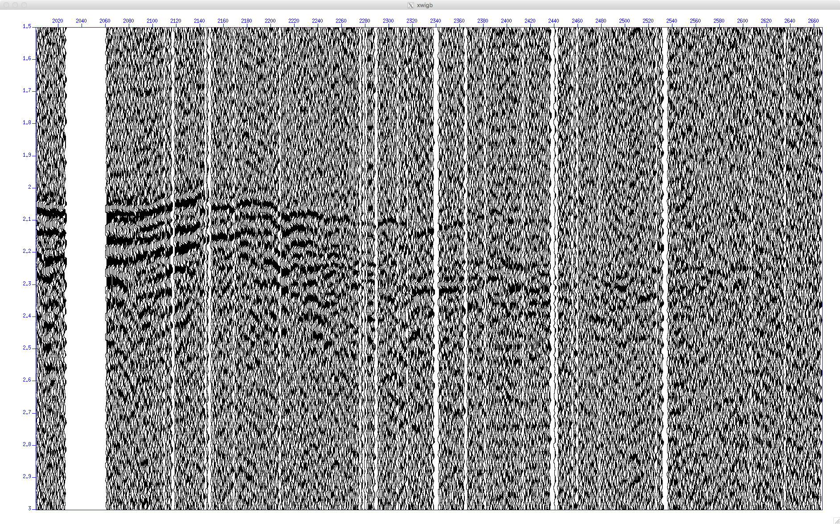
1700 verticals – line100B

Slide 4
A2000 Verticals – line100B

Slide 5
B2000 Verticals – Line100B

Slide 6
C2000-line100B

Slide 7
D2000-line100B

