Slide 1
3D Array Processing
Sept 8, 2016, DUGL telecon
Gary Pavlis

Slide 2
Motivation
Getting back to catalog preparation wanted to process the array like an array
Locate events using array phase velocity as an observable instead of 24 to 48 picks of P and S phases
In an anisotropic medium the measured phase velocity will NOT always be the direction of the great circle path to the source – can we observe this?
For our planned work on particle motions it is essential to measure phase velocity in 3D for comparision.

Slide 3
Issues:
Free surface effect alters the pulse shape at different depths
Frequency dependent coherence variations with station spacing
  mostly an issue for surface sites where the aperture is quite large for the band mining explosion light up (Known since the 1960s)

Slide 4
Example: surface array

Slide 5
2000 subarray
I did not expect to see that variation underground

Slide 6
4000s subarray
Better here, but still large variations in signal details

Slide 7
Array Processing Approach
Dbxcor – aligns signals by cross-correlation
Determine slowness vector from measured lags
Full array
  Does not stack very well due to signal variation with depth
  Correlations were unstable due to secondary peaks from free surface interaction
  Sorry I don’t have graphics to show this

Slide 8
Alternative approach
Run dbxcor in subarray mode
  Examples earlier were gathers from that approach
  Correlate and stack (beamform) from each subarray independently
  Pick arrival time on each subarray beam independently
Estimating phase velocity
  Simple linear inverse problem: t=t_0 + u*x
  Lightening fast least squares solution by QR algorithm
  Problem: awful residuals and absurd answers fitting full array
  Reason: static shifts between subarrays created by independent picks

Slide 9
Static shift solution: grid search subarray shifts and minimize residuals
TEXT output for mining explosion in Wyoming located southwest of array:
evid=1 orid=1
Best fit solution found at row=15 and column=57
Minimum rms=0.600137
Best fit arrival time shifted to origin= 5/28/2015 19:04:26.207
Best fit slowness vector=(0.146715 0.0645722 0.292438 )
Azimuth=66.2447
Inclination angle=28.7288
Surface phase velocity=6.23845
Total slowness=0.333489 which is a velocity of 2.9986

Slide 10
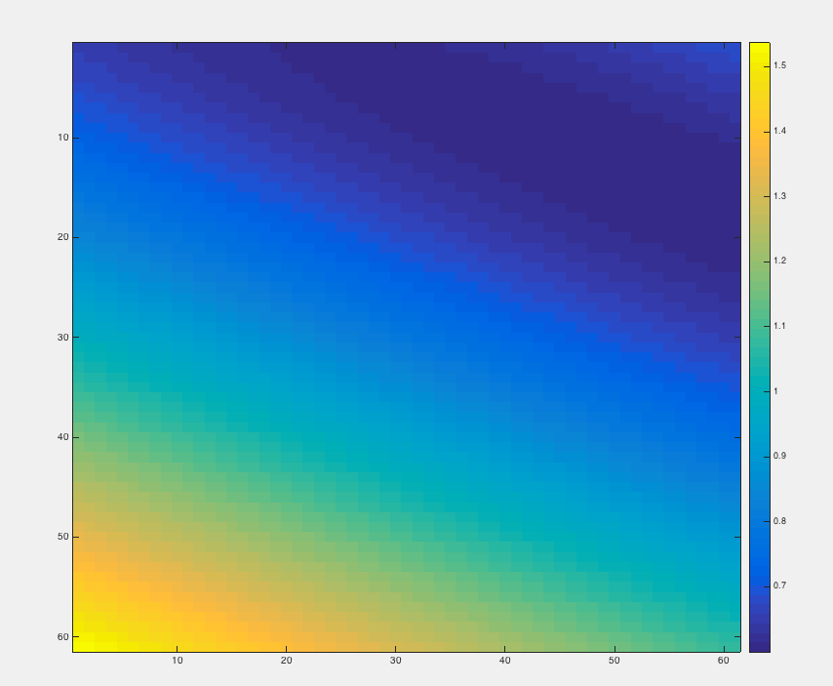
Residual surface
Minimum residual point

