Slide 1
Free Surface Reflections at Homestake Mine
Ross Caton

Slide 2
Homestake Reflection Experiment
Goal was to observe reflections off of the free surface from the 2000 ft. level.
Used a “land streamer” that we dragged across ~ 1 km of drift
Used an “airless jackhammer” as a source

Slide 3
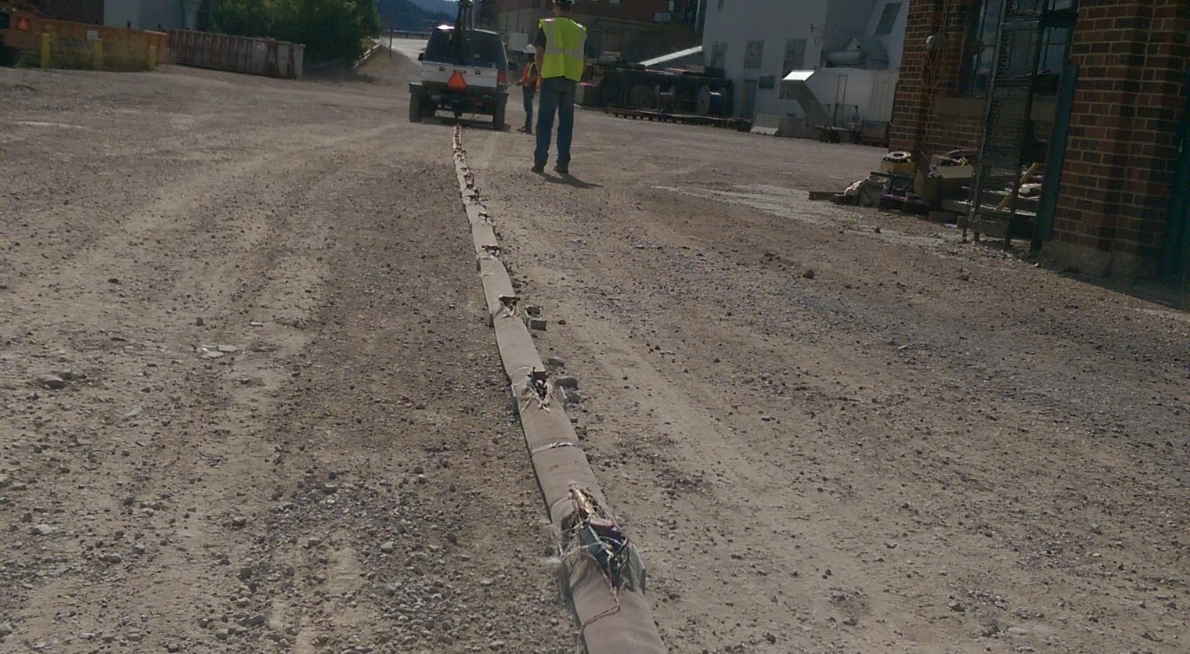
Land Streamer

Slide 4
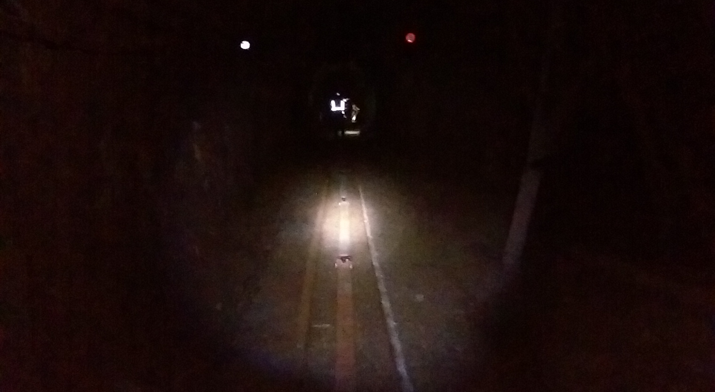
Land Streamer

Slide 5
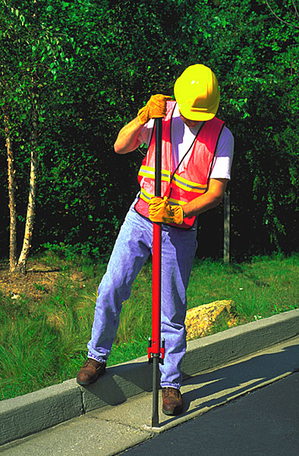

Slide 6
Data processing steps
Kill bad traces
CMP binning
Filter
F-k filter
2 x Deconvolve
NMO: constant velocity, 6500 m/s
Stack
F-k filter

Slide 7
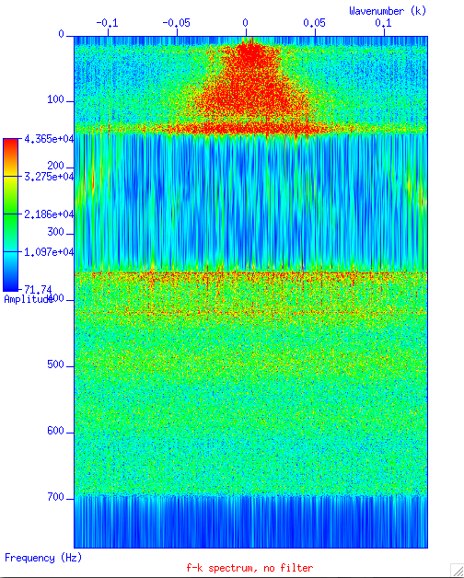

Slide 9
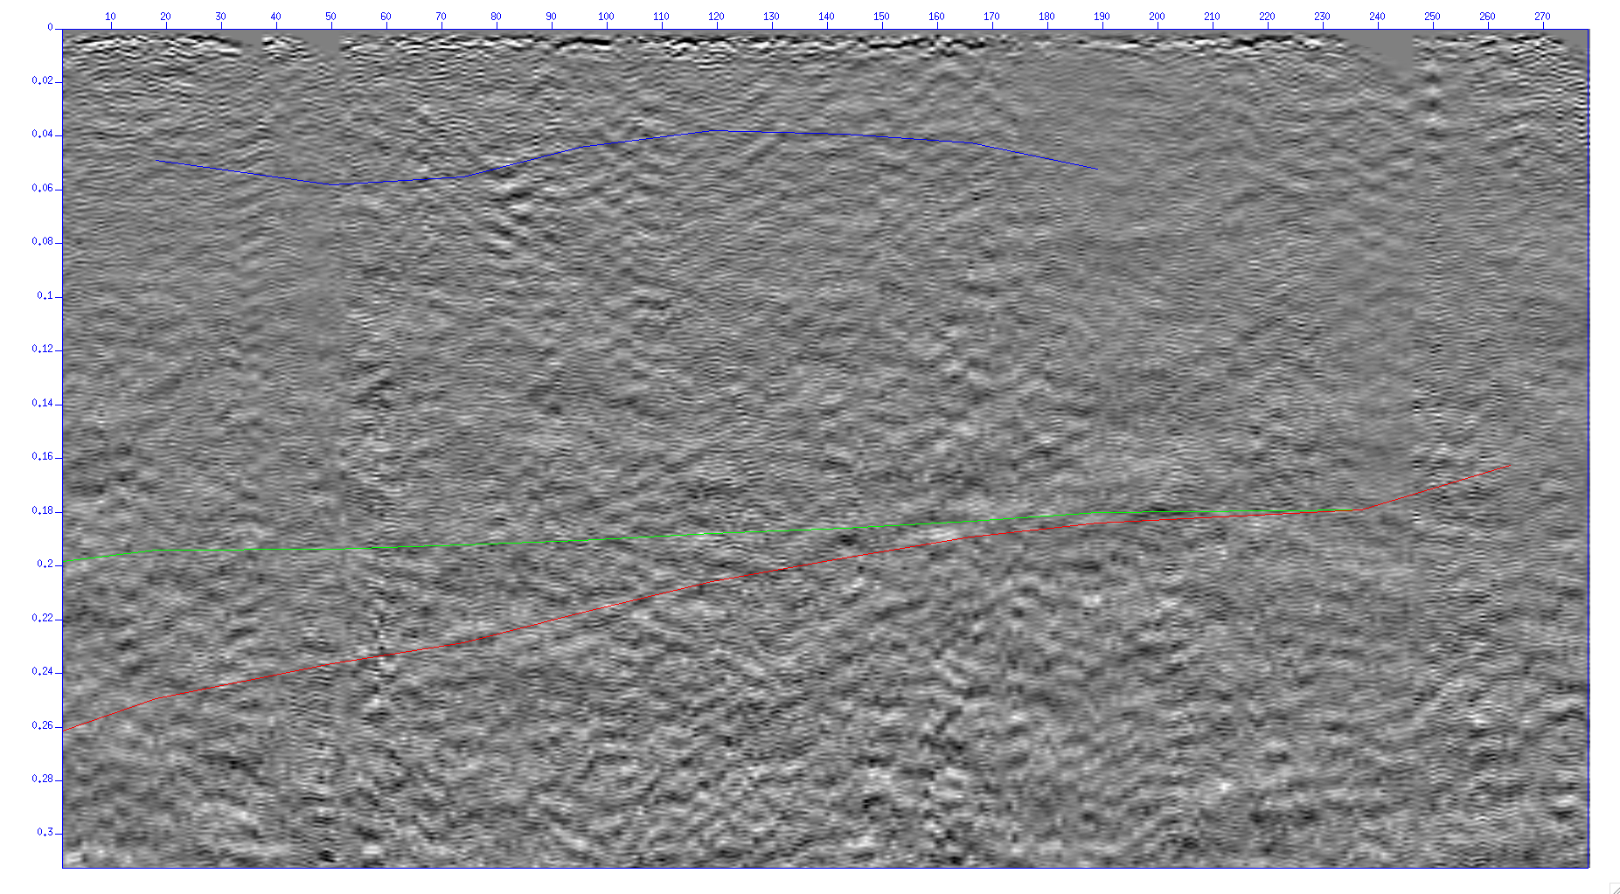
Processed Image

Slide 10
Questions?

