Slide 1
COrE+ Optics options

Slide 2
Introduction
Telescope designs typical to CMB polarisation missions
Crossed Dragonian design (side fed or front fed)
Off axis Gregorian
Challenge to achieve best optical performance
Maximise mechanical space of launcher volume
Match to focal plane pixel f number
Is a cold stop required? – may need re –imaging optics

Slide 3
Introduction
Any 2-reflector system consisting of offset confocal conic sections has an "equivalent paraboloid" with the same effective focal length and aperture field distribution.
By adjusting the relative tilt of the parent conic symmetry axes, the
equivalent paraboloid can be made to be rotationally symmetric giving low cross-polarisation and low astigmatism.
This configuration, called a compensated system, is said to obey the Mizuguchi-Dragone condition.
A classical compensated off-axis 2-mirror telescope has zero linear astigmatism, and coma(the dominant remaining aberration) identical to that of an on-axis paraboloidal mirror with the same focal ratio.

Slide 4
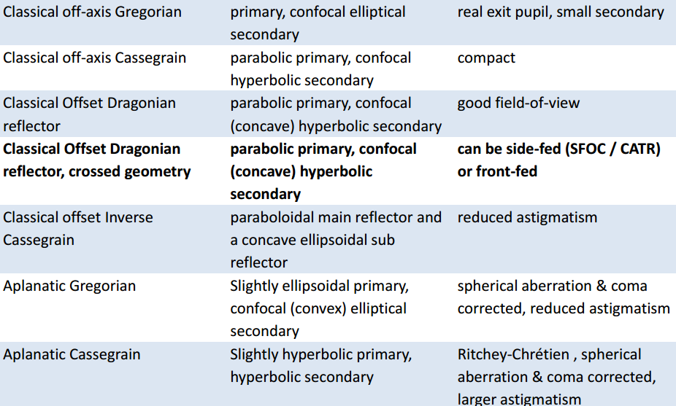
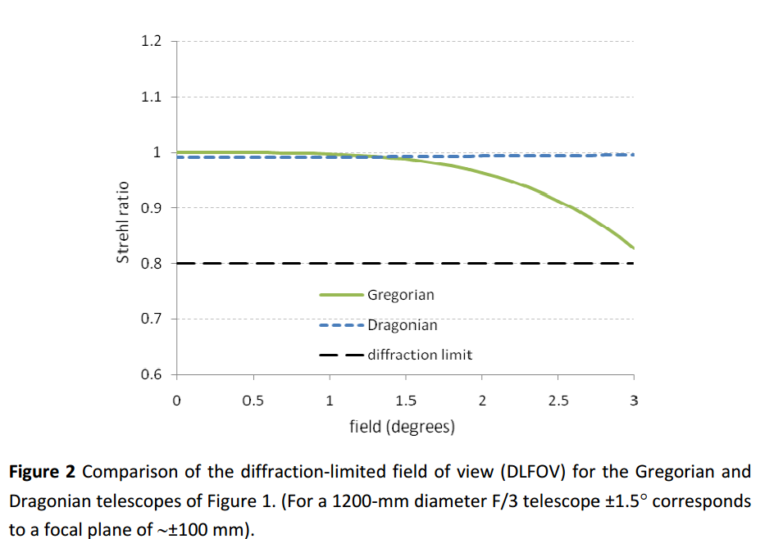
Telescopes
Dragonian designs naturally
can accommodate the largest
focal plane areas

Slide 5
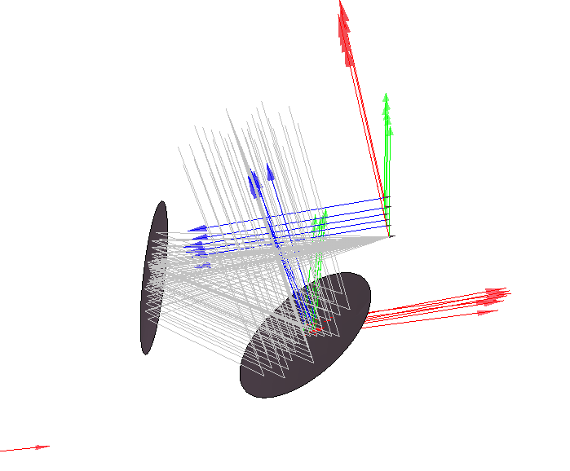
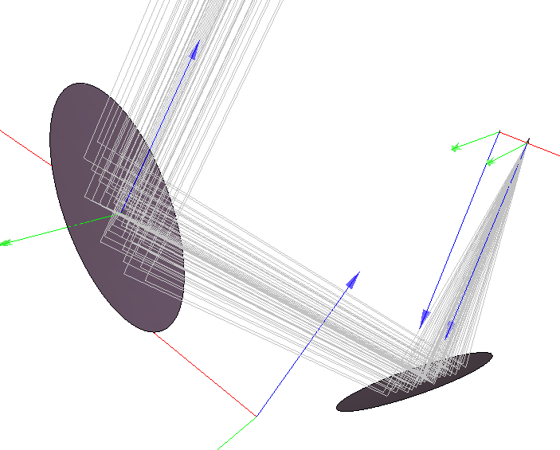
Telescopes
Side fed Dragonian has lowest aberration (beam ellipticity) but fits poorly in launcher volume due to required configuration.
Front feed Dragonian fits better but has lower optical performance overall.
For F/2 1.5 m Dragonian designs, beam ellipticity is 5% worse towards edge of focal plane (400 mm diameter) values of circa 2 and 7 % at 200 in x direction respectively
Reimaging optics can be added if planar pixels in focal plane
Front fed
Side fed

Slide 6
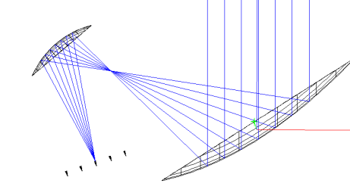
Telescopes
Gregorian designs have naturally smaller diffraction limited focal plane areas
Can be used to reasonable performance out to 150 mm focal plane radius.
Has equivalent performance to side fed Dragonian out to this range but quickly deteriorates, < 20 % ellipticity values at  20 % at 100 GHz for F/2 design with 1.5 m primary
Potential to add cold stop between mirrors
Reimaging optics can be added if planar pixels in focal plane
Gregorian designs

Slide 7
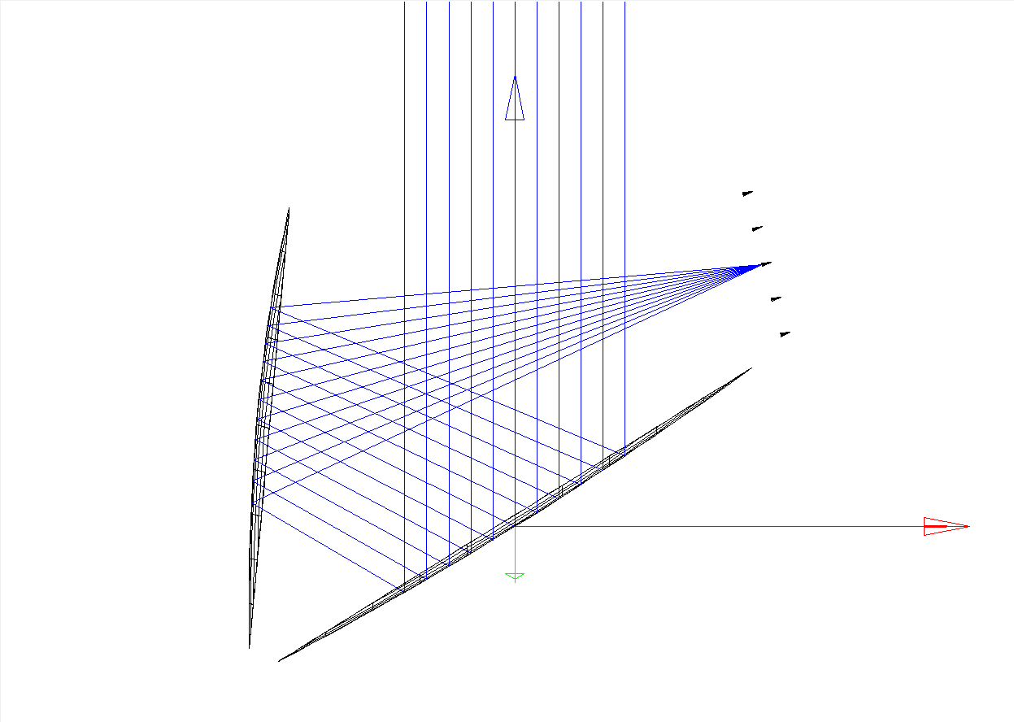
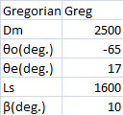
Comparison of Dragonian/Gregorian 2.5m primary mirror
Gaussian beams at 100GHz propagated to sky, central beams compared to beams at +-200 to 400 mm over focal plane in x and y directions
Name | Dragonian
D(mm) | 2600
θe(deg.) | 15
θc(deg.) | -120
l(mm) | 2400
α(deg.) | -30.3614
β(deg.) | -89.6385
θo(deg.) | -81.1642
e | 1.75123
Feq(mm) | 4937.2401
F(mm) | 9767.752
2c(mm) | 18032.021
do(mm) | 16733.3846
dcf(mm) | -1.7222
dcs(mm) | 1224.462
Ellipticity | Greg | Drag
Central | 0.002 | 0.003
200x | 0.034 | 0.044
-200x | 0.058 | 0.051
200y | 0.061 | 0.036
-200y | 0.058 | 0.036
400x | - | 0.065
-400x | - | 0.007
400y | - | 0.094
-400y | - | 0.095
2.5 m

Slide 8
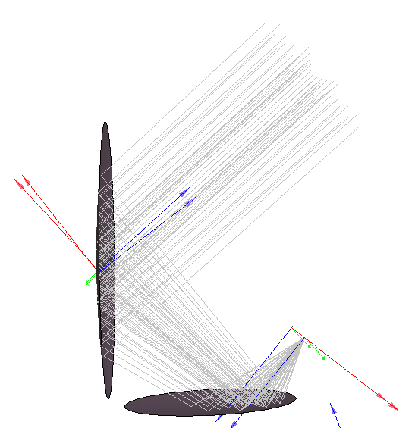
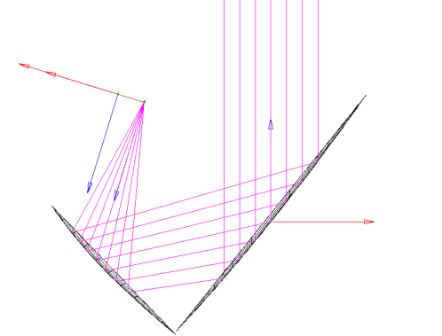
To be investigated for optical performance
Front fed Dragonian design fits well in Soyuz volume
2.5 m primary possible
Analysis ongoing

Slide 9
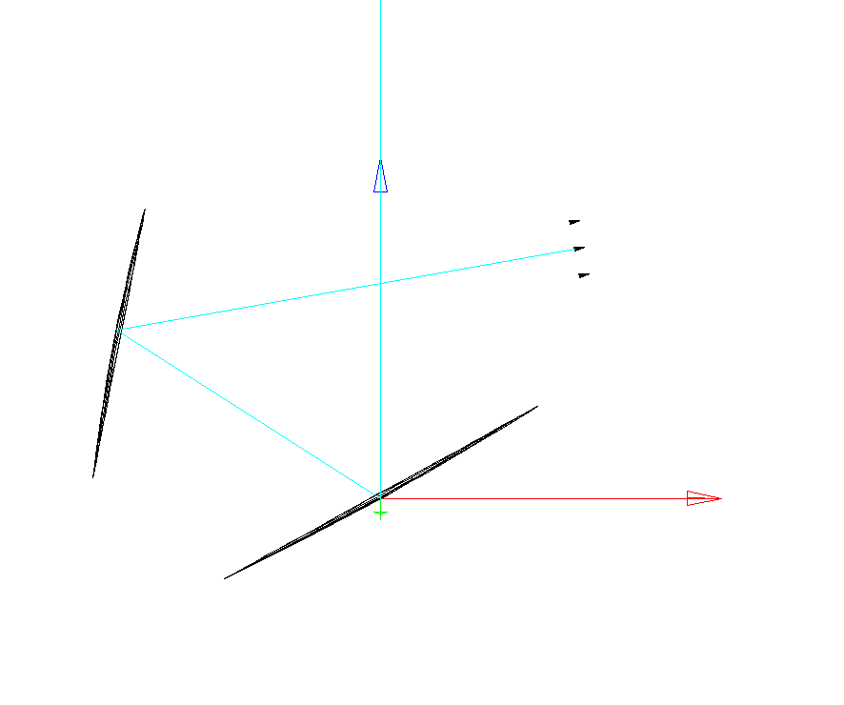
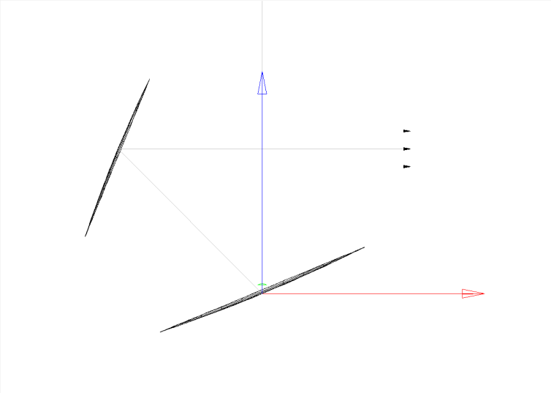
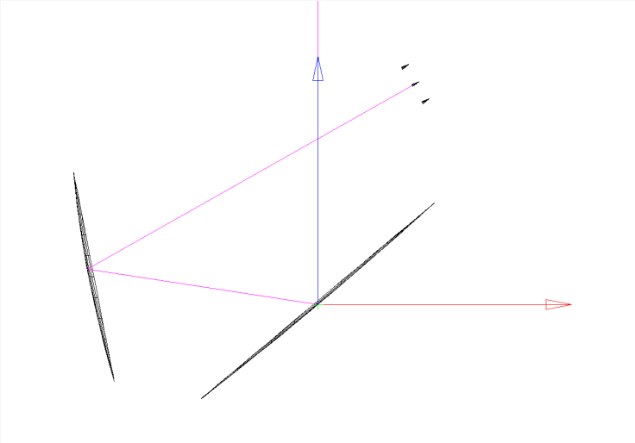
Side feed Dragonian configurations
θ_{c} =90
θ_{c} =100
θ_{c} =120
Name | θc80 | θc90 | θc100 | θc110 | θc120
Central | 0.000101 | 0.000616 | 1.95E-05 | 0.000864 | 0.016009
200x | 0.053205 | 0.026833 | 0.026944 | 0.02838 | 0.007188
-200x | 0.031153 | 0.007311 | 0.006309 | 0.00489 | 0.011693
200y | 0.021652 | 0.015817 | 0.018293 | 0.042852 | 0.017428
-200y | 0.021652 | 0.033722 | 0.037901 | 0.042852 | 0.017428
Gaussian beams at 100GHz propagated to sky from different focal plane locations. Central beams compared to beams at +-200 mm over focal plane in x and y directions. Ellipticity values quoted in table

Slide 10
Reimaging optics
Reimaging optics module can be included if required to place cold stop for planar pixels
Gaussian beam telescope configuration with 2 lenses is being investigated currently.
Paraxial lens options already added using ray tracing analysis.
Next step to add real lens – requires optimisation for aberration of focal plane
This work is on going and can be used with all telescope designs
Beam near focal plane could also be reflected via dichroic or reflecting half wave plate
Slides following show ZEMAZ analysis of F/2 designs with projected apertures of 1.2m.
Ray spot diagrams indicate optical performance with/without paraxial re imaging optics for the three designs (side, front Dragonian and Gregorian)
Introduction of real lens not complete yet.

Slide 11
Dragonian-F/2
Optical Parameter | Value
ϴ_{e} | 15 degrees
ϴ_{p} | 90 degrees
ϴ₀ | 50 degrees
D_{m} | 1.2 m
l | 1.2 m
Rays launched at 0 degrees and +/- 3.5 degrees
2.059 m from focal plane to lowest edge of secondary mirror

Slide 12
Dragonian-F/2
Spreads for each ray lie within Airy disk of system
Performance acceptable at extremes of FOV
Focal plane approximately 313 mm diameter
Focal plane is flat

Slide 13
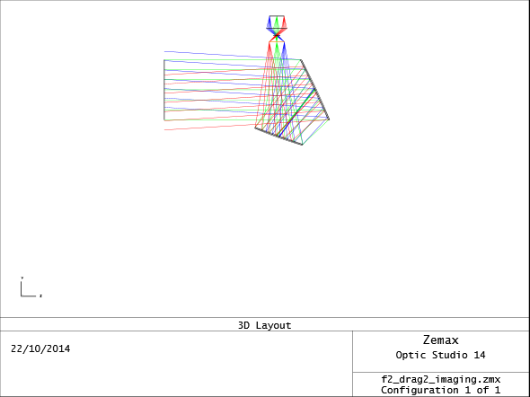
Dragonian-F/2 with reimaging
Added two ideal lenses for reimaging
Re-imaging optics add additional 0.517 m to system. Focal plane to bottom of secondary mirror is now 2.576 m.
Can include a stop between the lenses
Approximate diameters: Lens at reflector focal plane: 313mm. Refocusing lens: 410mm. Focal plane: 297mm
Ideal Paraxial lenses of focal length 130mm

Slide 14
Dragonian-F/2 with reimaging
Spreads for each ray again lie within Airy disk of system, performance acceptable at extremes of FOV
Airy radius is now approx 300 microns smaller relative to case with no re-imaging
RMS radius of rays is increased for -3.5 and 0 degree cases. Image less focused. Slight improvement for 3.5 degrees
Adding tilt can improve performance for one extreme at the expense of the other

Slide 15
Gregorian-F/2
Optical Parameter | Value
ϴ_{e} | 14.25 degrees
ϴ_{p} | 90 degrees
ϴ₀ | 50 degrees
D_{m} | 1.2 m
Rays launched at 0 degrees and +/- 3.5 degrees to cover entire field of view
2.382 m vertically, 1.738 m horizontally
Focal plane is curved

Slide 16
Gregorian-F/2
Spreads for each ray lie within Airy disk of system, which is smaller than Dragonian case
RMS spread of rays is higher than for Dragonian, particularly for 0 degree case
Performance acceptable at extremes of FOV
Focal plane approximately 324.4 mm diameter

Slide 17
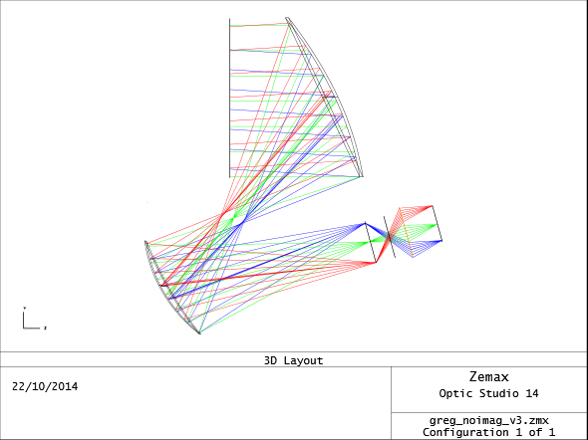
Gregorian-F/2 with reimaging
Added two lenses for reimaging
Re-imaging optics add additional 0.497 m to system. Focal plane to bottom of secondary mirror is now 2.235 m.
Can include a stop between the lenses
Approximate diameters: Lens at reflector focal plane: 324.4mm. Refocusing lens: 392.802mm. Focal plane: 284.986mm
Ideal Paraxial lenses of focal length 130mm
Telecentricity is improved following re-imaging

Slide 18
Gregorian-F/2 with reimaging
Spreads for each ray again lie within Airy disk of system, performance acceptable at extremes of FOV
Airy radius is now approx 600 microns smaller relative to case with no re-imaging
RMS radius of rays is less, but still performs worse than the Dragonian equivalent
Adding tilt can improve performance for one extreme at the expense of the other

Slide 19
Above analysis shows that re-imaging using a perfect paraxial lens in a Gaussian telescope configuration improves performance, with the Dragonian system performing best
Real lenses will be implemented in Zemax in the future, when the telescope design is finalised, in order to correctly model their impact on the system
A front-fed Dragonian will now be considered, to maximise the use of space in the Soyuz capsule

Slide 20
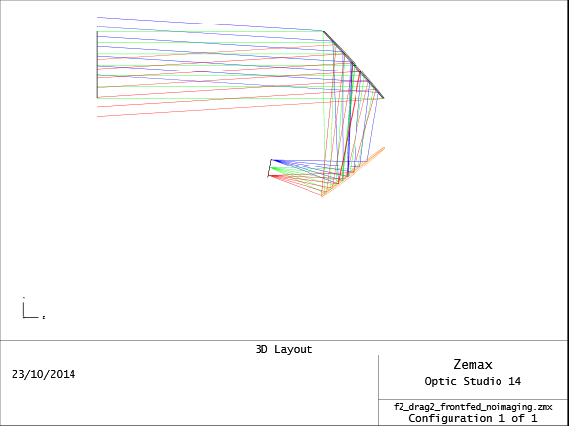
Front-fed Dragonian-F/2
100 GHz. Rays launched at 0 degrees and +/- 3.5 degrees to cover entire field of view
This arrangement makes better use of the available space within the Soyuz fairing and has the added advantage of the focal plane being relatively telecentric and pointing away from the sky, reducing potential sidelobe issues

Slide 21
Front-fed Dragonian-F/2
0 degree rays lie with Airy disk, and the extremes of the FOV lie mainly in this region too
Airy radius is now approx 14 microns larger relative to side fed case
RMS radius of rays is much larger, giving poorer optical performance than in the side fed case, as expected
Re-imaging optics using paraxial lenses will have a similar effect as before

