Slide 2
Locations and Hours
East Bank—Main Clinic
St. Paul Clinic—Satellite Clinic
Open Monday through Friday
Open Saturdays Fall and Spring semester

Slide 3
Physical Therapy
Primary Care Clinic
Travel Immunizations
Urgent Care
Women’s Clinic
Dental Clinic
Eye Clinic
Gopher Quick Clinic
Massage Therapy
Mental Health Clinic
Nutrition Services
Pharmacy
Flu Clinics
Held Each Fall

Slide 4
All students have
access to Boynton
no matter what
health plan
they have.

Slide 5
Students with active health plan coverage that pay the University’s Student Services Fee receive most services at Boynton at no cost or reduced cost.*
Students on the Graduate Assistant Health Plan have a $10 copay for most services at Boynton.

Slide 6
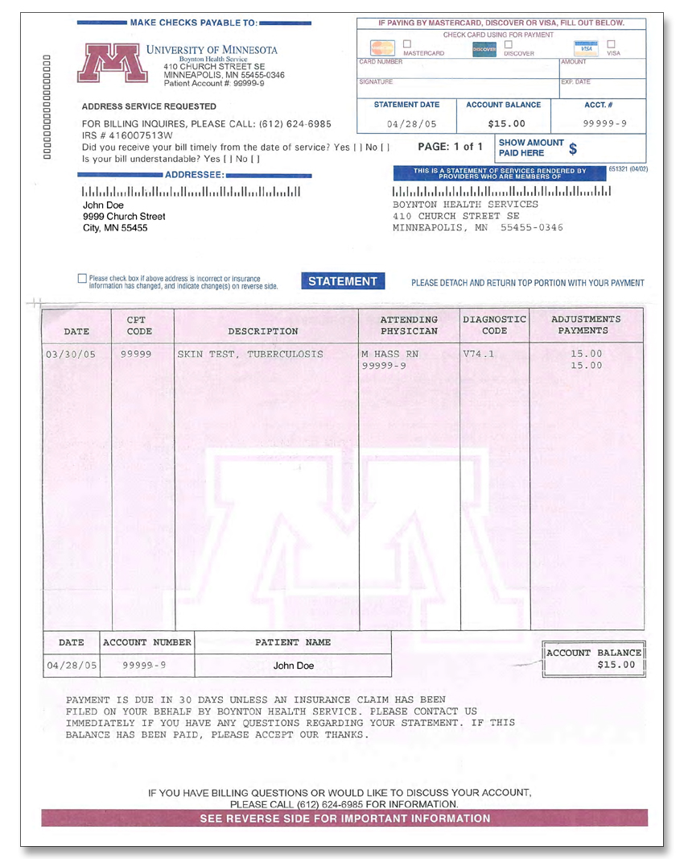
*After receiving care at Boynton, your health plan will be billed and in most cases any remaining balance will be covered by the Student Services Fee.

Slide 7
The Student Services Fee only applies to visits at Boynton Health Service and is only effective if student has active health plan coverage.
For full explanation, visit
www.bhs.umn.edu/health-care-coverage.htm

Slide 8
At Boynton Health Service
HIPPA Privacy regulations are observed
Medical records are confidential
Boynton has been accredited by AAAHC since the 1970s.

Slide 9
University-Sponsored
Graduate Assistant
Health Plan

Slide 10
Eligibility
To be eligible to enroll in the plan, you must hold at least 25% assistantship or fellowship (195 hours) in a qualifying job class
You must submit an enrollment form

Slide 11
Enrollment
Must enroll by September 16, 2013 or within 14 days of appointment start date
Coverage for late enrollees will start the day the Office of Student Health Benefits receives and verifies enrollment form
Dependent enrollment during open enrollment only

Slide 12
Plan Details
Year-round coverage
HealthPartners network
No age limits for GA
Convenient access on campus

Slide 13
Plan Details
No pre-existing condition exclusions
Prescription drug coverage
No deductible in network
$200 deductible out-of-network, 20% co-pay after deductible
Emergency travel assistance via FrontierMEDEX

Slide 14
Dental Benefits at Boynton’s Dental Clinic
GAs receive two cleanings per year and one set of X-rays per year at no cost to them
Dependents of GAs receive discounted services (regardless of their enrollment in the plan)

Slide 15
Summer Coverage
Automatic if enrolled spring semester
Coverage cost based on average assistantship during the school year
Premium may be due
If you do not need coverage for summer, please cancel before May 31

Slide 16
Continuation of Coverage
After loss of eligibility, you may continue coverage for up to 18 months at your own expense
Please inform the Office of Student Health Benefits when you lose your eligibility

Slide 17
Cost for Graduate Assistant
Total cost $358.82 per month
$103.76 premium billed to your U account each semester
The University share (of the $358.82 balance) is equal to twice your appointment percentage.

Slide 18
Cost for Dependents
The University subsidizes dependents on the Graduate Assistant Health Plan at 65 percent of the lower cost plan.
The amount subsidized by the University has already been subtracted from the following amounts.
Dependent coverage cannot be billed to your U account.

Slide 19
Cost for Dependents
Plan 1
Spouse/SSDP $287.84/month
One Child $188.35/month
2+ Children $338.98/month
Family $488.13/month
Plan 2
Spouse/SSDP $199.70/month
One Child $128.47/month
2+ Children $229.54/month
Family $347.11/month

Slide 20
Plan details are available for download
www.shb.umn.edu

Slide 21
From the staff at Boynton Health Service and the Office of Student Health Benefits, thank you for choosing the University of Minnesota!

